Slide 1
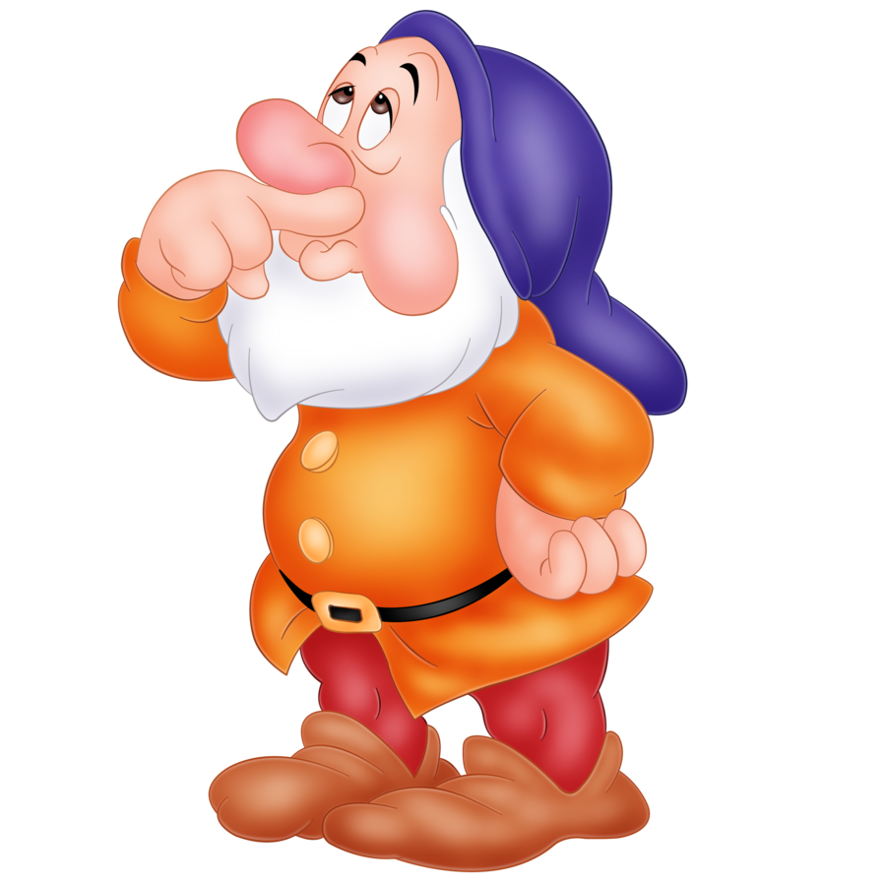
Bold Beginnings

Slide 2
Learning Intentions and Success Criteria
We are learning to capture our audience with a bold beginning.
I will be successful if…
I can talk about what makes writing enjoyable or boring.
I can use action at the start of my writing.
I can listen to others beginnings and give them warm and cool feedback.

Slide 4
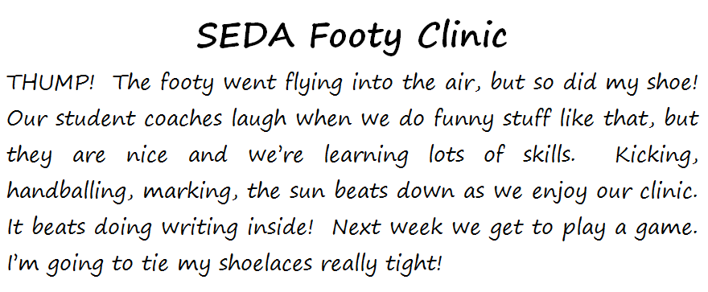

Slide 5
Task: 5 x Bold Beginnings Step 1 Step 2 Step 3

Slide 6
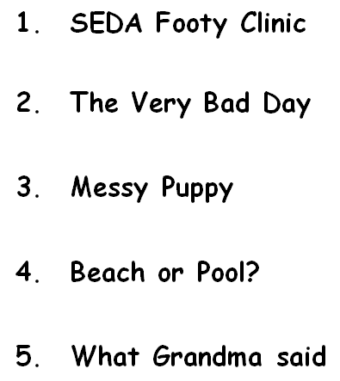
Today’s 5 Topics

Slide 7
In your group, read title 1. Talk to each other about all the different topics and ideas that come into your head when you think about the words in this title. Make sure everyone gets lots of turns. You can say just a word or a whole sentence. No writing, just talking and listening. Do the same thing for topics 2-5.
Step 1

Slide 9
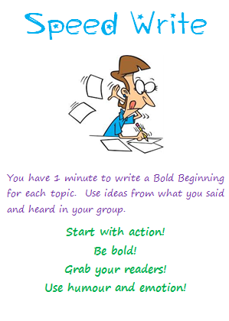
Go to your own seat.
You have 1 minute to write a Bold Beginning for each topic. Use ideas from what you said and heard in your group.
Start with action!
Be bold!
Grab your readers!
Use humour and emotion!
Step 2

Slide 10
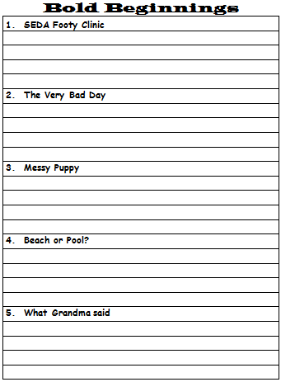

Slide 12
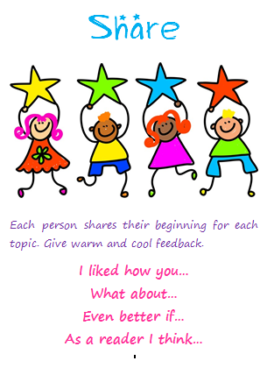
Return to groups to share.
Each person shares their bold beginning for each topic. Give warm and cool feedback.
I liked how you…
What about…
Even better if…
As a reader I think…
Step 3

Slide 14
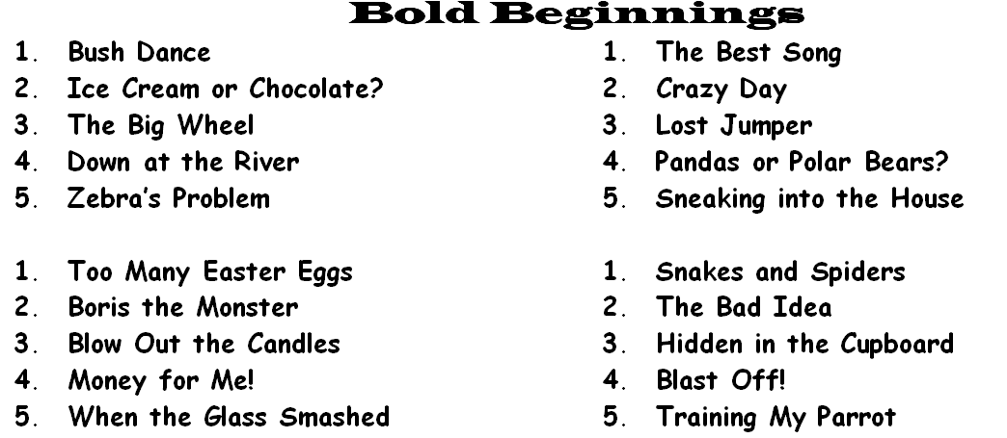
This same 3 step routine used each day with 5 topics.
Suggested to do this for 2 weeks (we only did 5/6 sessions) .
5 different topics each day. Eg.

Slide 15
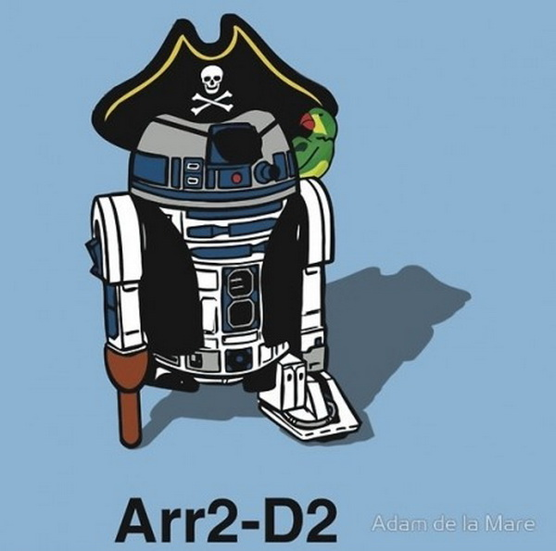
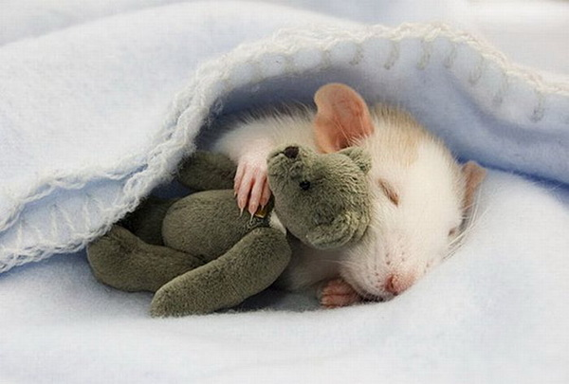
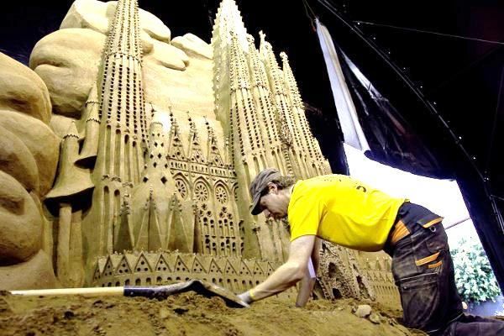
Prompts can be visual as well

Slide 16
Modelling a quick sample each day give scaffolding for the kids who need ‘inspiration’.

Slide 17
Some of the best!

Slide 18
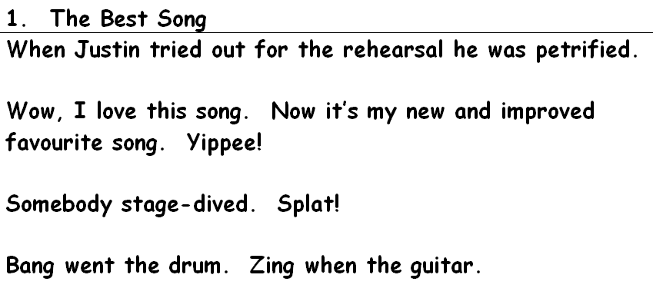
Some of the best!

Slide 19
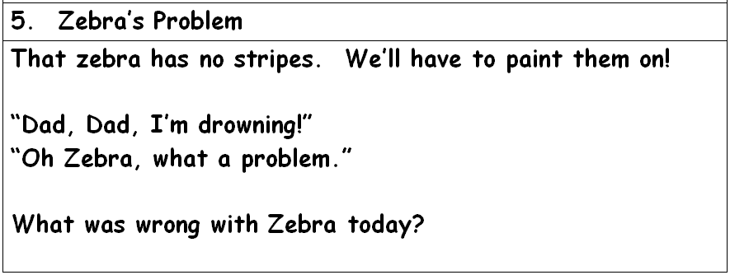
Some of the best!

Slide 20
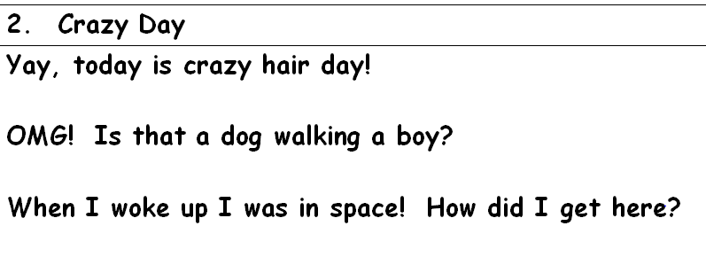
Some of the best!

Slide 21
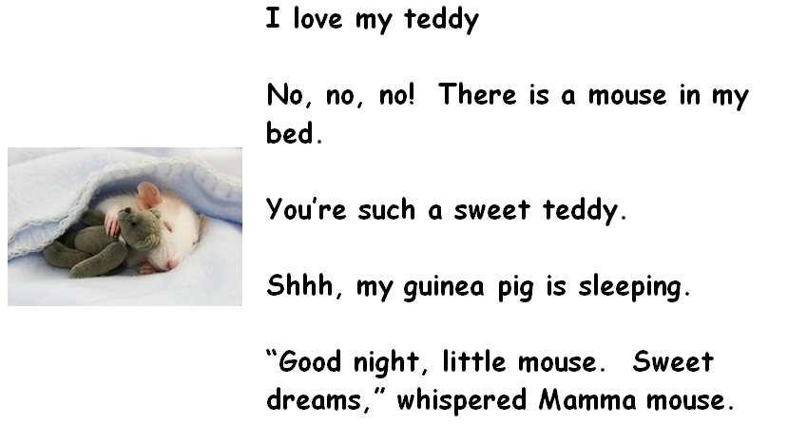
Some of the best!

