Slide 1
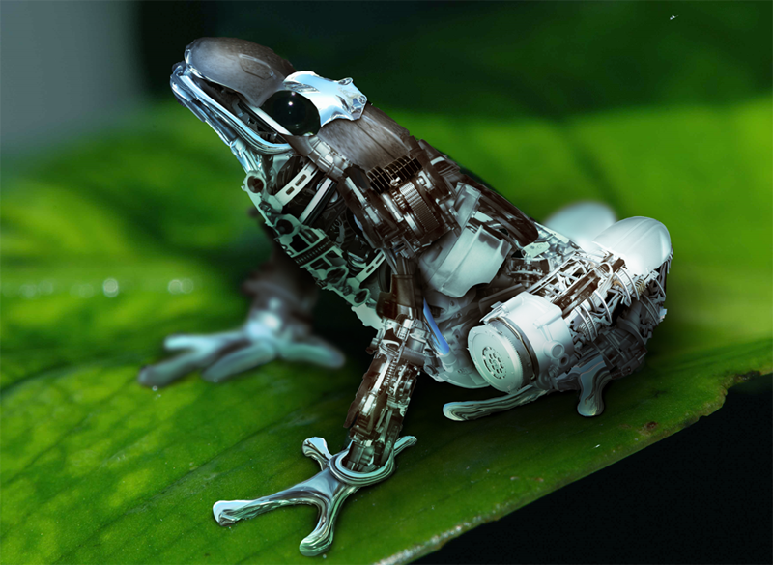
Today’s Joke:
Q.
What does a
robot frog say?
A.
Rib-bot

Slide 2
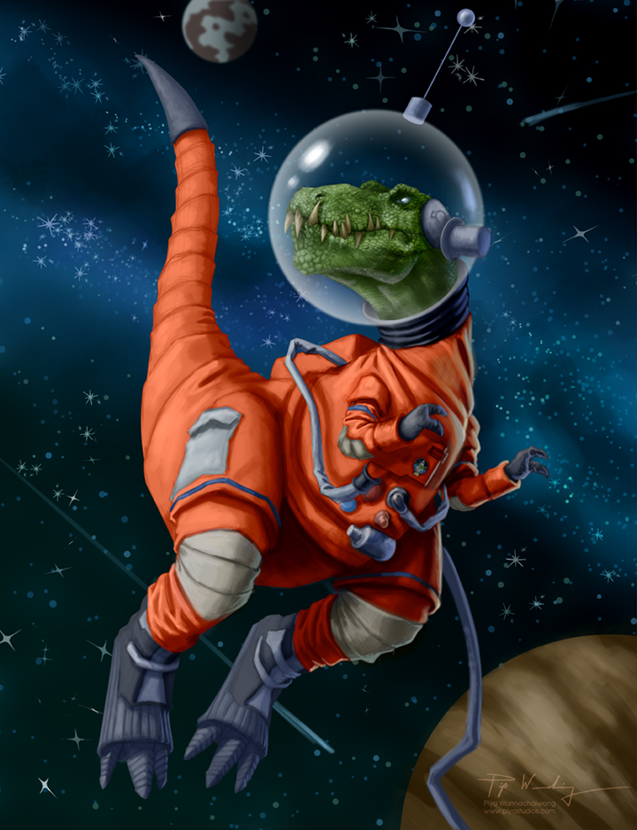
Today’s Joke:
Q.
What do you
call a dinosaur
in space?
A.
astronautasarus

Slide 3
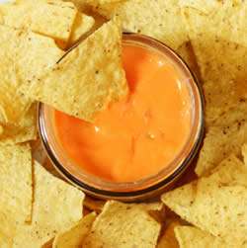
Today’s Joke:
Q.
What do you
call cheese that’s
not yours?
A.
Nacho cheese

Slide 4
Today’s Joke:
Q.
What did 0 say
to 8?
A.
Dude, nice belt!

Slide 5
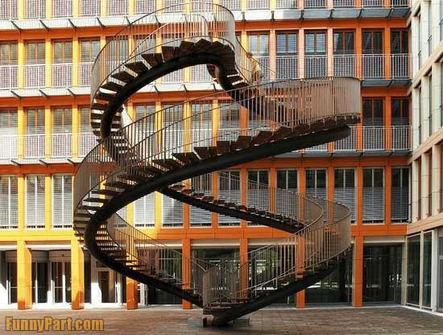
Today’s Joke:
Q.
What goes up
and down but
doesn’t move?
A.
Stairs

Slide 6
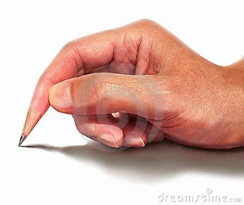
Today’s Joke:
Q.
Which hand
is best to write
with?
Neither! It’s best
to write with a pen.
A.

Slide 7
Today’s Joke:
Q.
Why do you go
to bed each night?
A.
Because the bed
won’t come to you!

Slide 8
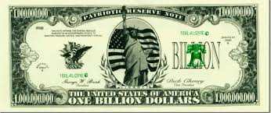
Today’s Joke:
Q.
What’s the richest
kind of air?
A.
Billionair

Slide 9
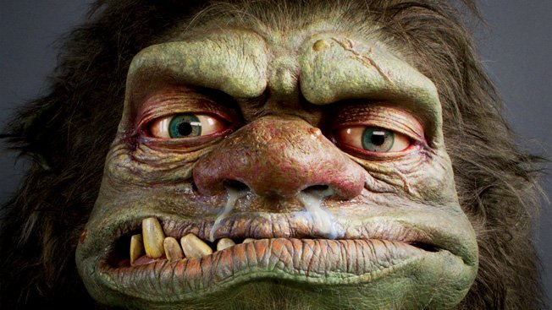
Today’s Joke:
Q.
Which runs faster,
hot or cold?
A.
Hot! Everyone
can catch a cold!

Slide 10
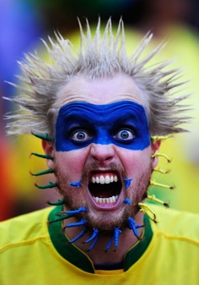
Today’s Joke:
Q.
Why is it so hot in
a football stadium
after a game?
Because all of the
fans have left!
A.

Slide 11
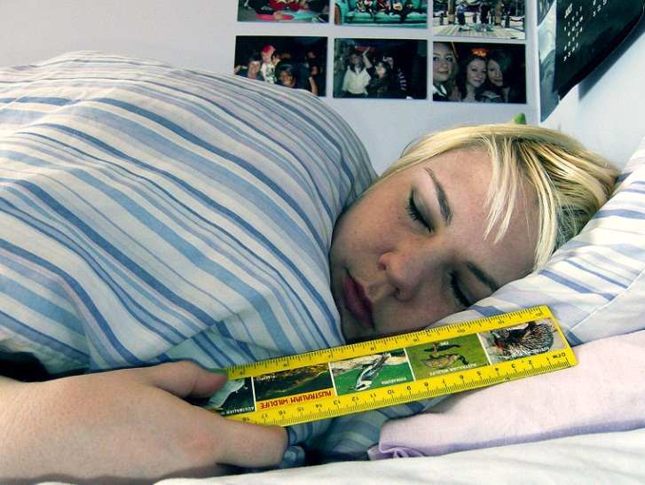
Today’s Joke:
Q.
Why did the kid
sleep with a ruler?
A.
To measure how
long she slept!

Slide 12
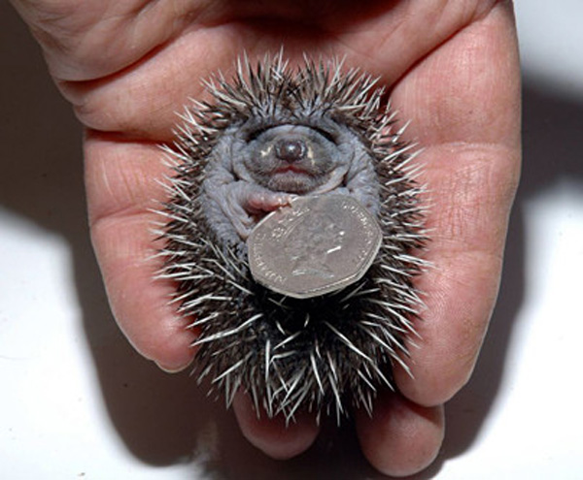
Today’s Joke:
Q.
What has a head
and a tail, but
no legs?
A coin.
A.

Slide 13
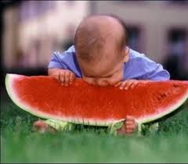
Today’s Joke:
Q.
When do you
go on red
and stop
on green?
A.
When you eat
a watermelon.

Slide 14
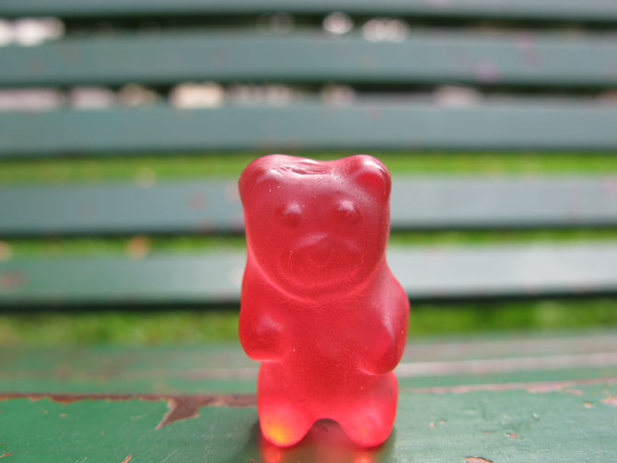
Today’s Joke:
Q.
What kind of bear
has no teeth?
A.
A gummy bear.

Slide 15
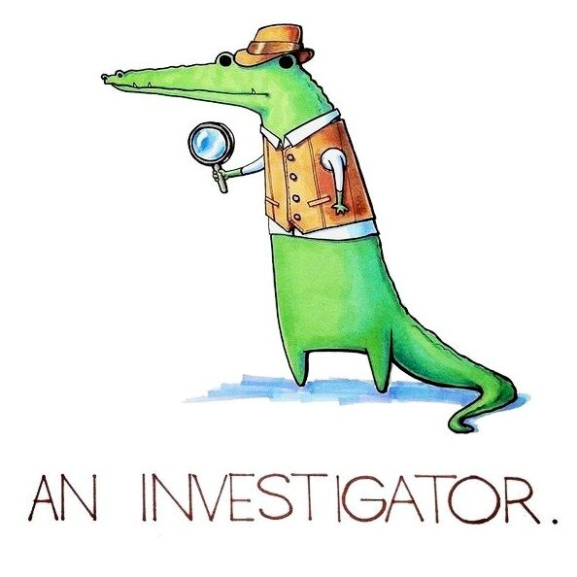
Today’s Joke:
Q.
What do you call
an alligator
in a vest?
A.

Slide 16
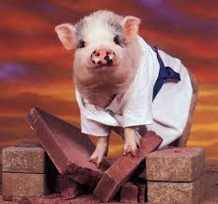
Today’s Joke:
Q.
What do you call
a pig that knows
Karate?
A.
A pork chop.

Slide 17
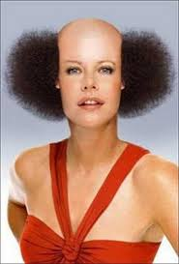
Today’s Joke:
Q.
How did the
barber win
the race?
A.
He knew a short cut.

Slide 18
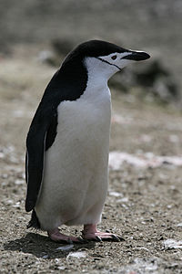
Today’s Joke:
Q.
What do you call
a penguin
in the desert?
A.
Lost.

Slide 19
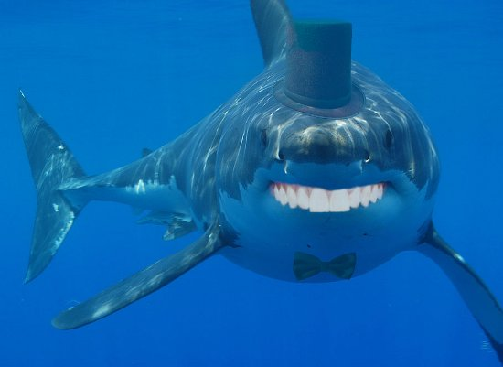
Today’s Joke:
Q.
What is a sharks
favorite game?
A.
SWALLOW the leader!

Slide 20
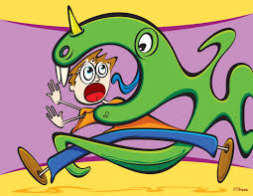
Today’s Joke:
Q.
What should you
take with you if
a monster invites you
for dinner?
A.
Someone who is a
slower runner than you!

Slide 21
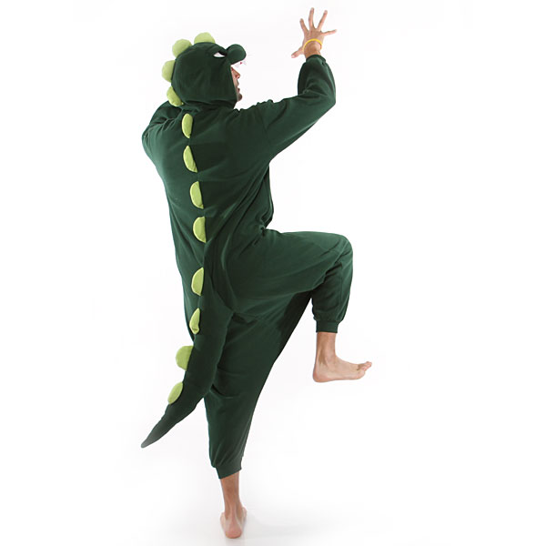
Today’s Joke:
Q.
What’s red
on the
outside and
green on the inside?
A.
A t-rex wearing
red pajamas.

Slide 22
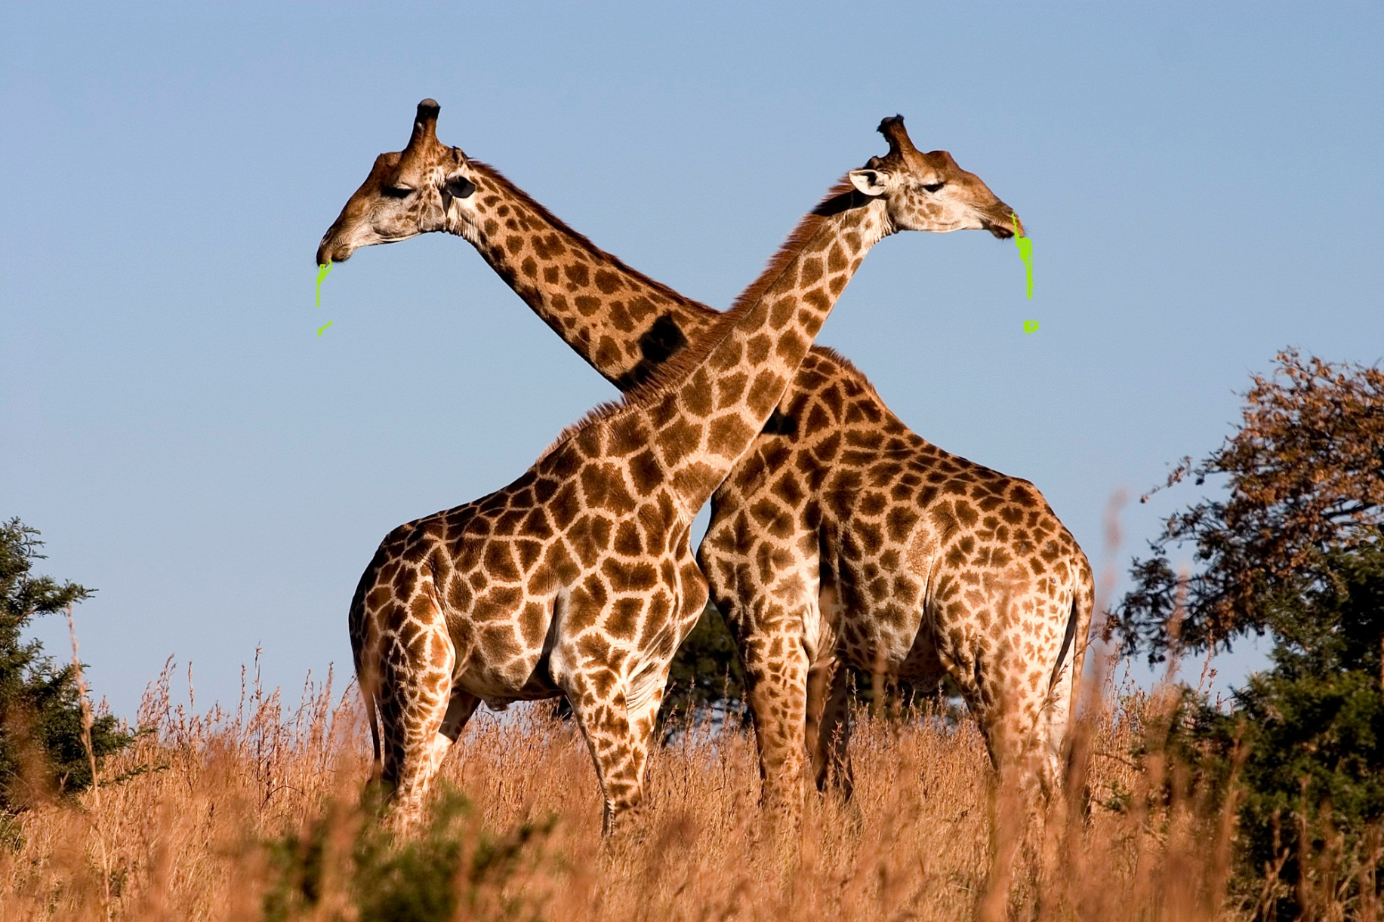
Today’s Joke:
Q.
What’s green
and slimy and hangs
on trees?
A.
Giraffe boogies.

Slide 23
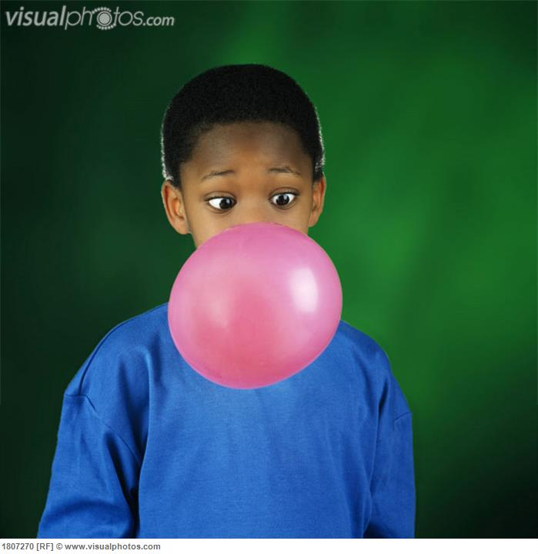
Today’s Joke:
Q.
What do you call
a train full
of gum?
A.
A chew-chew train.

Slide 24
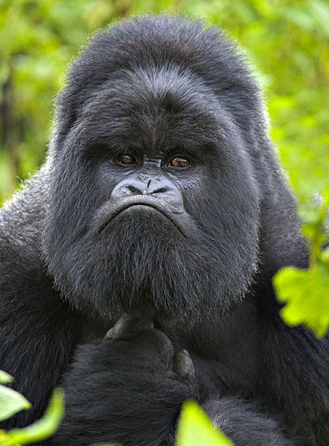
Today’s Joke:
Q.
What do you call
a 2,000 lb. gorilla?
A.
Sir.

Slide 25
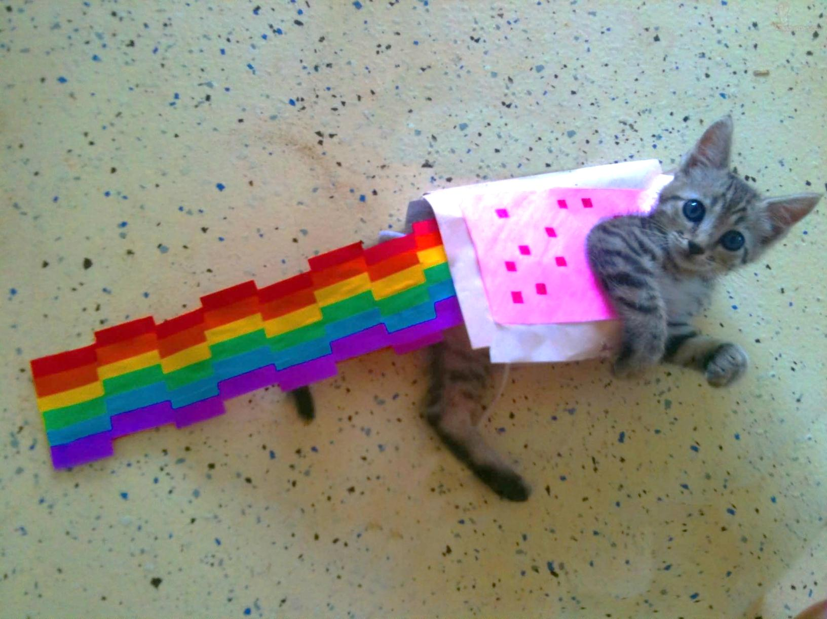
Today’s Joke:
Q.
What bow can’t
be tied?
A.
A rainbow.

Slide 26
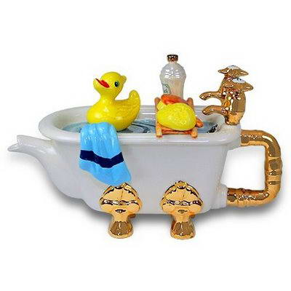
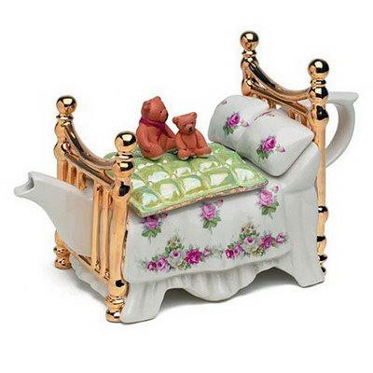
Today’s Joke:
Q.
What starts with
‘t’, ends with ‘t’ and
is filled with ‘t’?
A.
teapot.

Slide 27
Today’s Joke:
Q.
Why is ‘b’ such
a hot letter?
A.
It makes oil → boil.

Slide 28
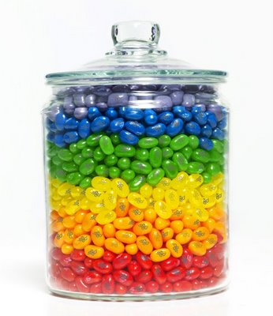
Today’s Joke:
Q.
How many jelly
beans can you put
in an empty jar?
A.
Only one – after that
it’s not empty anymore.

Slide 29
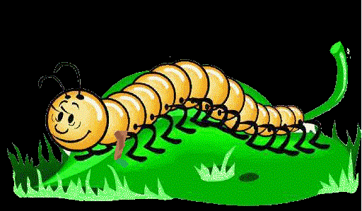
Today’s Joke:
Q.
What goes
99-thump, 99-thump
99-thump?
A.
A centipede with a
wooden leg.

Slide 30
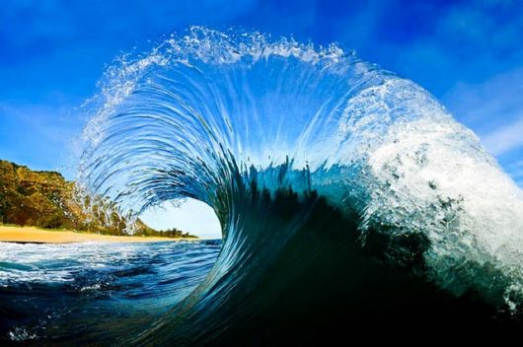
Today’s Joke:
Q.
How did the
ocean say goodbye?
A.
He waved.

Slide 31
Today’s Joke:
Q.
How did the tree
say goodbye?
A.
“I gotta leave”.

Slide 32
Today’s Joke:
Q.
How do you know
if a clock is hungry?
A.
When it goes back
four seconds.

Slide 33
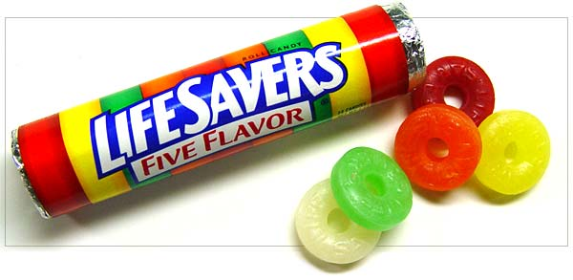
Today’s Joke:
Q.
What kind of candy
should you eat
if you’re about
to die?
A.

Slide 34
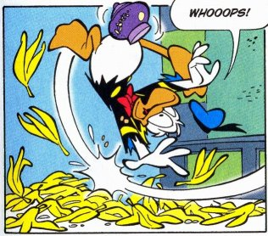
Today’s Joke:
Q.
Why does a banana
use suntan lotion?
A.
So it won’t peel.

Slide 35
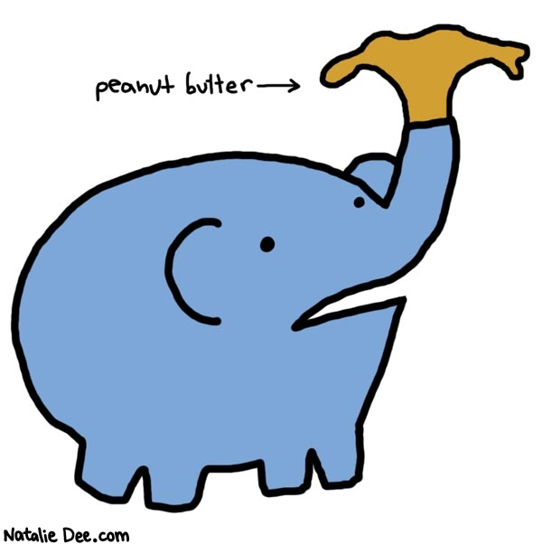
Today’s Joke:
Q.
What should you
give a sick
elephant?
A.
Lots of room!

Slide 36
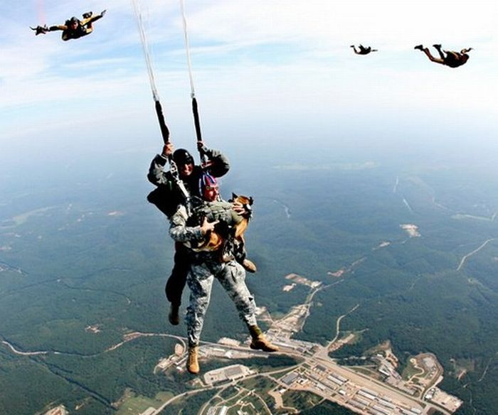
Today’s Joke:
Q.
Why don’t blind
people skydive?
A.
Because it scares
the living daylights
Out of their dogs!

Slide 37
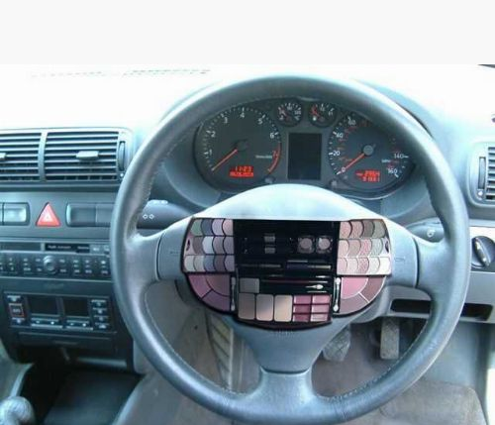
Today’s Joke:
Q.
How many wheels
does a car have?
A.
Five, counting the
steering wheel!

Slide 38
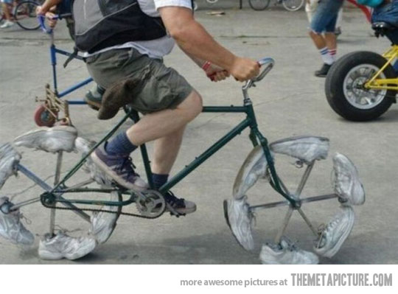
Today’s Joke:
Q.
Why can’t a
bicycle stand?
A.
Because it’s
two-tired!

Slide 39
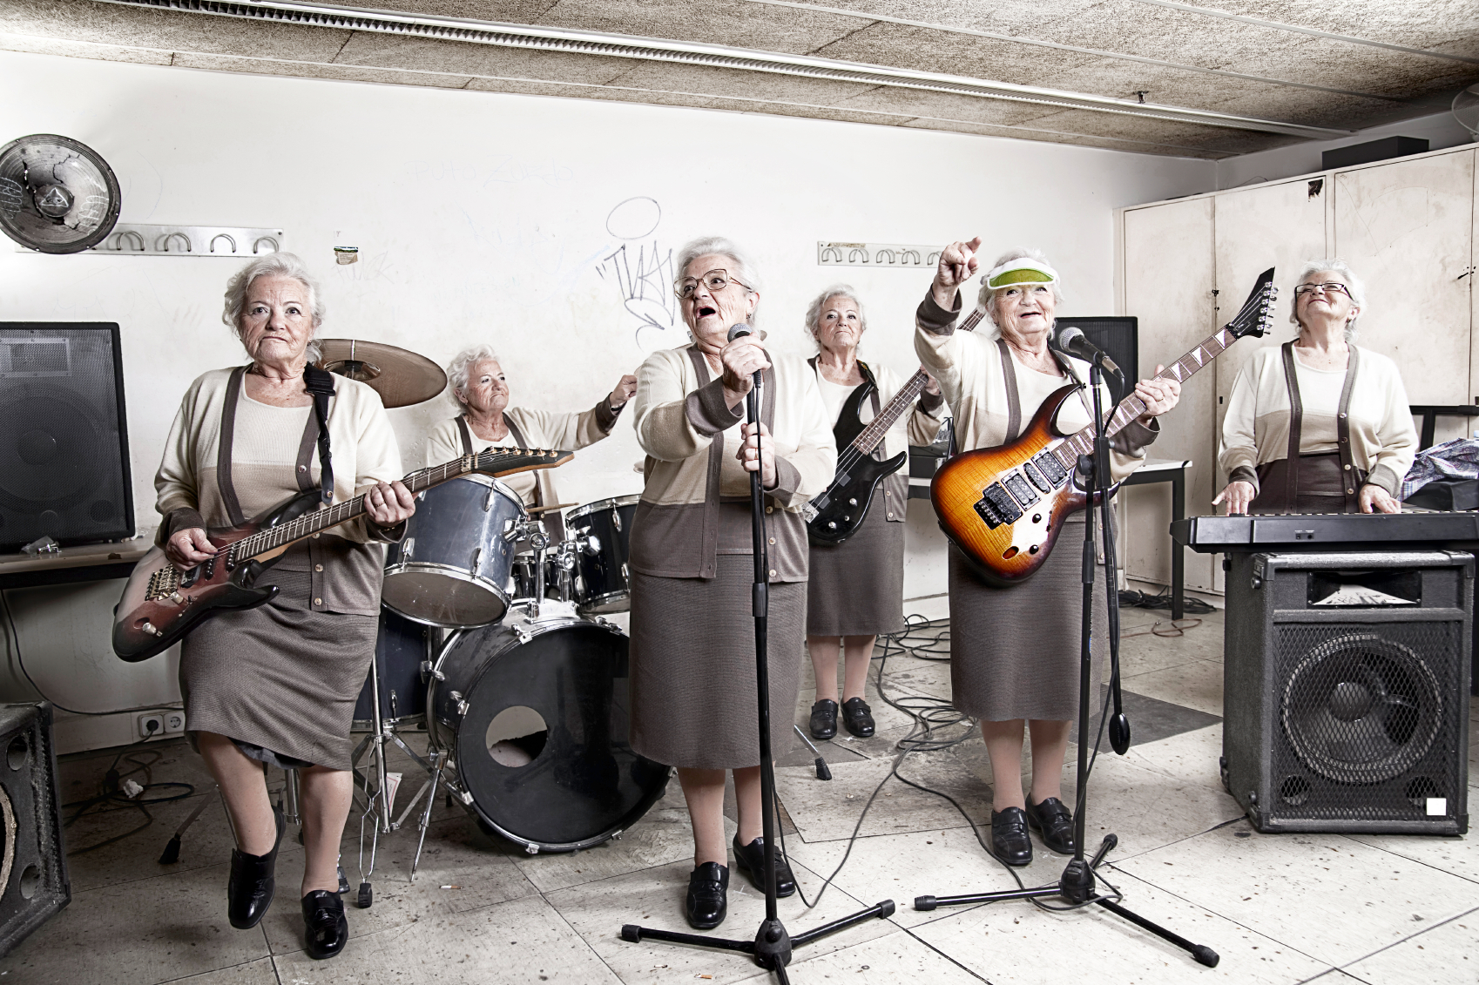
Today’s Joke:
Q.
Why did grandma
have wheels put
on her rocking chair?
A.
So that she could
rock & roll!

Slide 40
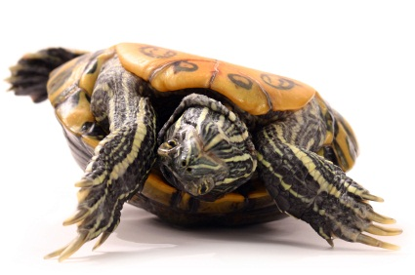
Today’s Joke:
Q.
What’s green then
yellow, green then
yellow?
A.
A turtle rolling
down a hill!

Slide 41
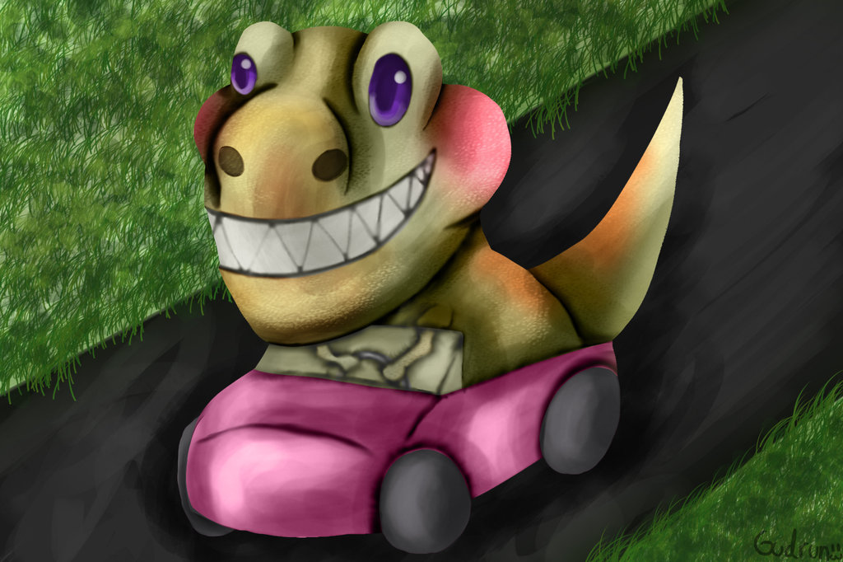
Today’s Joke:
Q.
What do you get
when dinosaurs
crash their cars?
A.
Tyrannosaurus Wrecks!

Slide 42
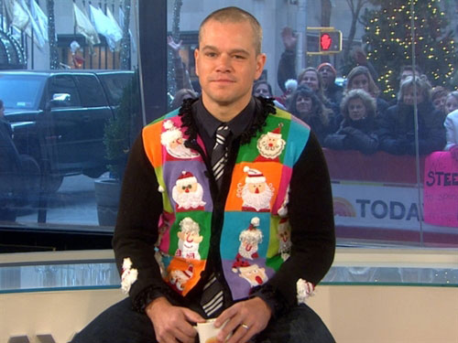
Today’s Joke:
Q.
What did the
policeman say to
the shirt?
A.
You’re under a vest!

Slide 43
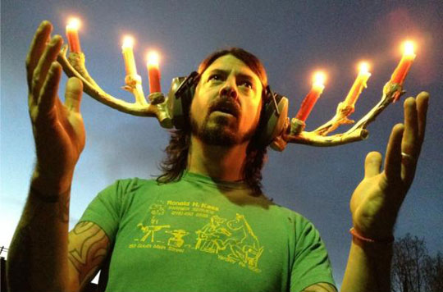
Today’s Joke:
Q.
What did one
candle say to the
other candle?
A.
Would you like to
go out with me
tonight!

Slide 44
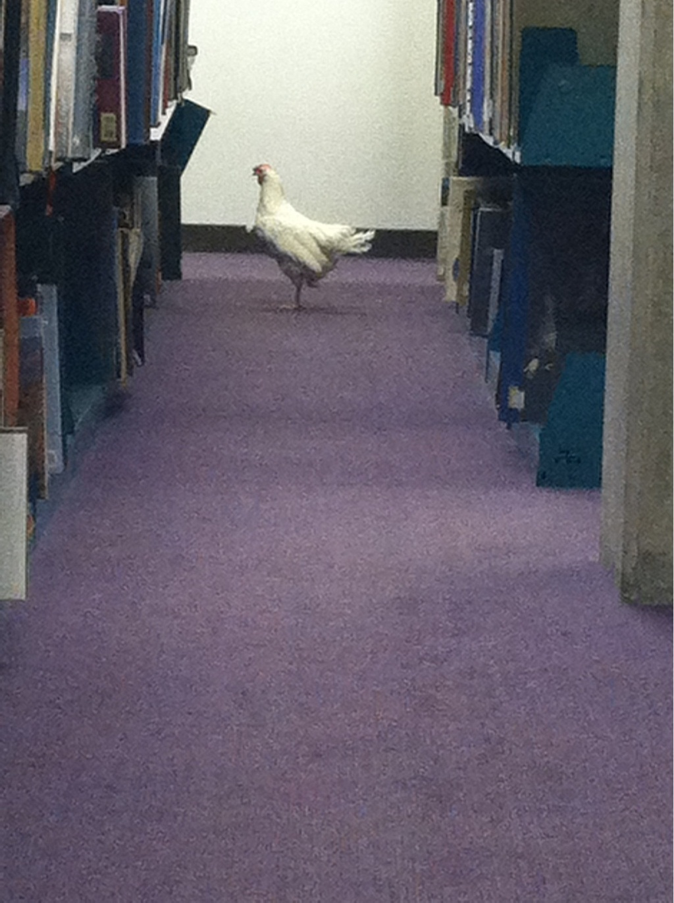
Today’s Joke:
Q.
What does a
chicken say when
he goes into a library?
A.
Book-book-book, book-book!

Slide 45
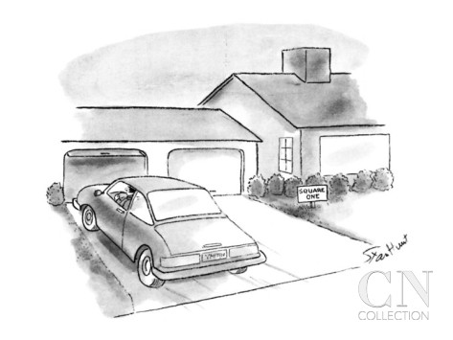
Today’s Joke:
Q.
When is a car
not a car?
A.
When it turns
into a driveway!

Slide 46
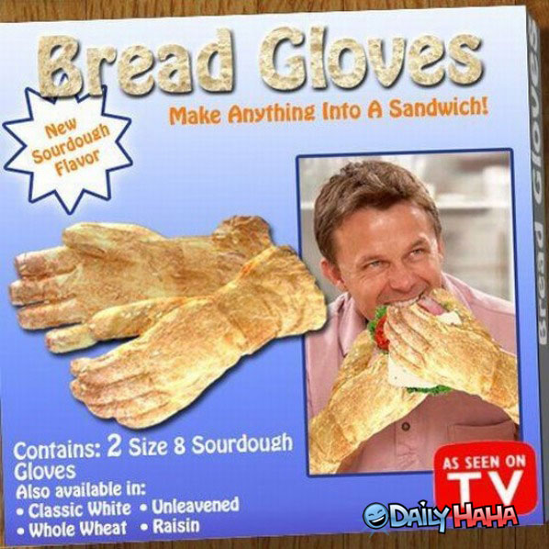
Today’s Joke:
Q.
What has fingers
but can’t use them?
A.
Gloves!

Slide 47
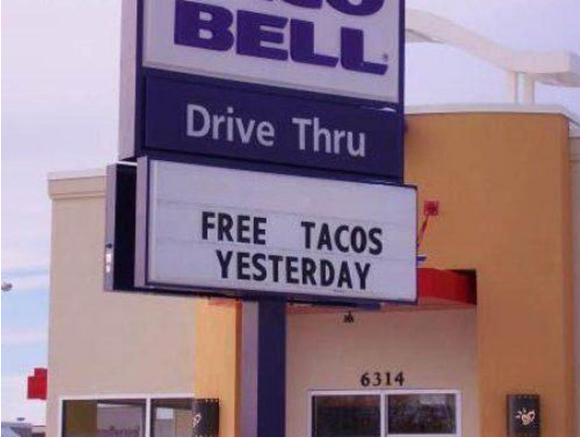
Today’s Joke:
Q.
What is something
everyone has seen
but will never see
again?
A.
Yesterday!

Slide 48
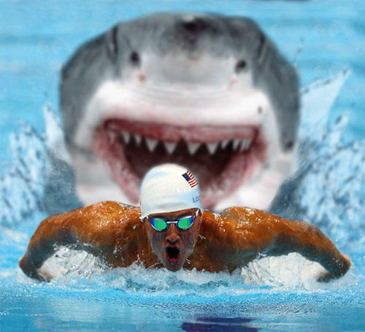
Today’s Joke:
Q.
What’s red and
mushy and found
between shark’s
teeth?
A.
Slow swimmers!

Slide 49
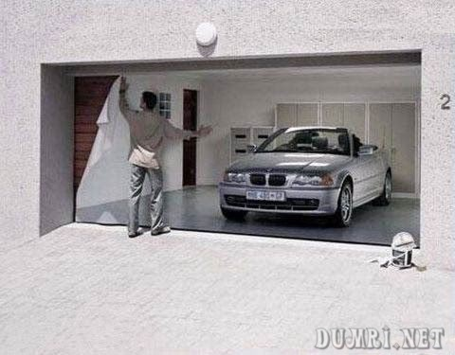
Today’s Joke:
Q.
What can hold a
car, but can’t lift
a feather?
A.
A garage!

Slide 50
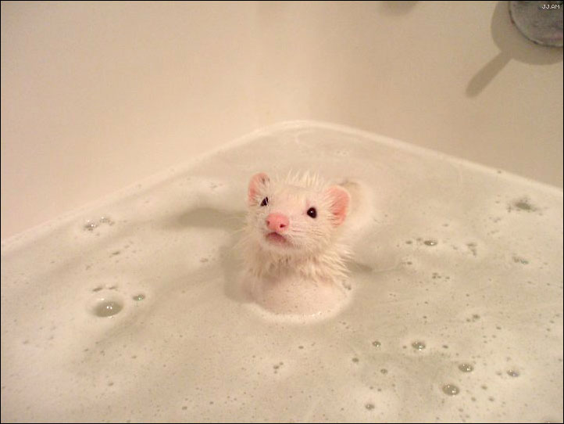
Today’s Joke:
Q.
How does a
mouse feel after
a bath?
A.
Squeaky clean!

Slide 51
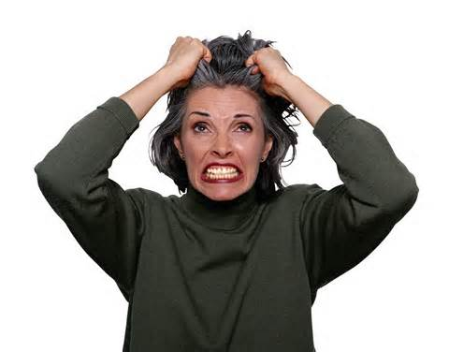
Oh, no!
That was the last joke!
Get more fun at:
Teachers Pay Teachers
Store Name:
Whole Brain Teaching
is for Everyone

