Slide 1
GRADE THREE AND FOUR WRITING IN TERM FOUR
Creating a
Writing Portfolio!

Slide 2
This term, we’ll be creating a Writing Portfolio of seven pieces of writing that you’ve created and written.
(you can do more)

Slide 3
(POETRY)
You will complete one piece of writing for each type of writing (genre) plus one of your own choice.

Slide 4
If you complete all seven, you may do others by yourself and with a partner.
You can choose the order in which you complete each piece.

Slide 5
Your teacher will help you complete the writing pieces, help you keep on track and assess your finished pieces using an assessment rubric which will give you a score out of 100 and an A+, A, B, C, D, mark.

Slide 6
You will need to go through 7 steps to complete each piece of writing:
1. Learn and Revise
What do I know about this type of writing? What do I need to find out?
Use the powerpoints and posters.
2. Think and Choose
Take some time to think about possible topics then make a choice.
3. Plan
Use the graphic organizer to plan out your writing.
4. Draft
Write!
Write on every second line.
5. Edit and Revise
Re-read, fix up, check, get a friend’s advice.
Eliminate all errors!
6. Produce
Time for your PUBLISHED PIECE. This is for your audience.
Attractive presentation.
7. Assess and Share
Your teacher will fill in the assessment rubric and you can share your achievement!

Slide 7
Each piece of writing will be completed on a manila folder which will help you complete each step and guide you through using the correct format for the genre (type of writing) you’ve chosen.

Slide 8
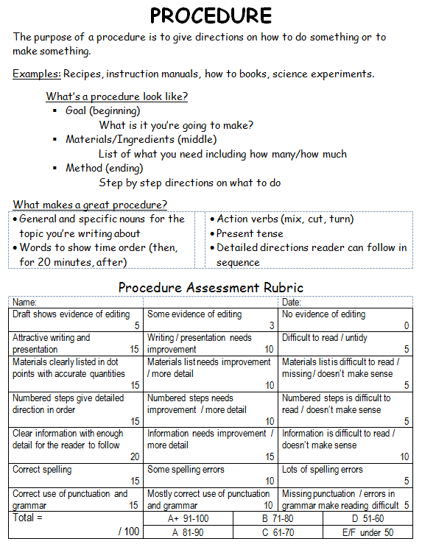
The front cover gives you some information about that genre.
It has the assessment rubric your teacher will use, so you will know exactly what you need to do to succeed and get the best marks you can.

Slide 9
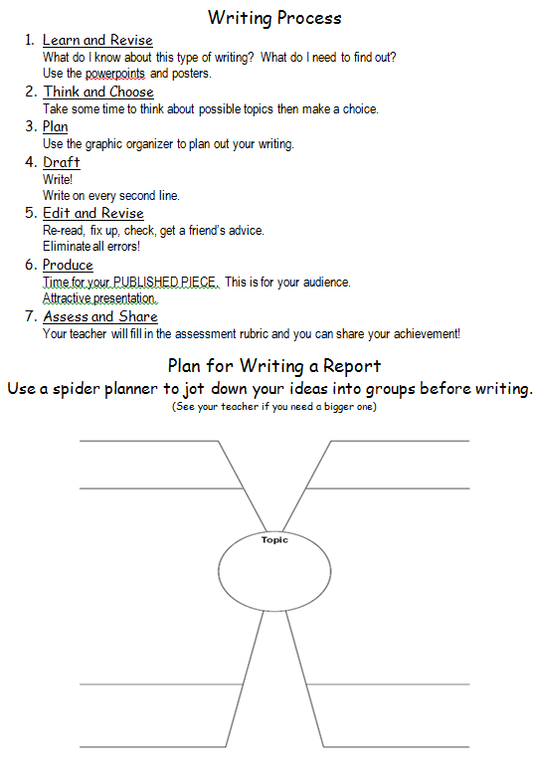
On the inside are the steps you need to follow and a plan you can use to help you. On the right is where you write your draft. Write on every 2nd line so you can edit easily. You can staple on more sheets if you need.

Slide 10
The back cover is where you write your PUBLISHED PIECE.
This is what your teacher will assess and what you will share.

Slide 11
You can share your work by:
Reading it to the class.
Displaying it for people to read.
Taking a photo to publish online.
Showing it to family and friends.

Slide 12
HELP!
What’s here to help you?
YOUR TEACHER
I can help keep you on track and answer your questions.
I can direct you to places where you’ll find the information you need.
I can work with an extra support group to complete a writing piece together.
I will give you feedback on how to improve your scores.
I will guide you when your work needs editing, but I won’t edit it for you!
I will give you suggestions for great writing!

Slide 13
THE WALLS!
Our displays have been set up to give you information, direction and ideas.
WRITING TUBS
These tubs have lots of resources that will help you.

Slide 14
YOUR CLASSMATES
We have great people in our room who are happy to help others.
Ask politely and appreciate their efforts.
Often the people you play with are not the best ones to choose to help with your work because you can get off track chatting about friendship stuff.
Be respectful and don’t waste others’ time.

