Slide 1
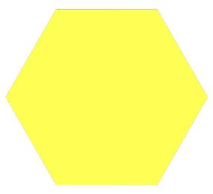
Pattern Block Fractions

Slide 2
If a trapezoid is 1 whole……

Slide 3
How much is…?
Where’s that on a numberline?
0
1
2
3

Slide 4
How much is…?
Where’s that on a numberline?
0
1
2
3

Slide 5
If a trapezoid is 1 whole……

Slide 6
How much is…?
Where’s that on a numberline?
0
1
2
3

Slide 7
How much is…?
Where’s that on a numberline?
0
1
2
3

Slide 8
How much is…?
Where’s that on a numberline?
0
1
2
3

Slide 9
How much is…?
Where’s that on a numberline?
0
1
2
3

Slide 10
If a trapezoid is 1 whole……

Slide 11
How much is…?
Where’s that on a numberline?
0
1
2
3

Slide 12
How much is…?
Where’s that on a numberline?

Slide 13
Now it’s your turn to investigate.
You’ll need:
1 dice
Pattern blocks - share!!!
(you won’t need the squares or the thin brown rhombuses)
Maths paper to record

Slide 14
If a rhombus is 1 whole, how much is…?
Using triangles:
Roll your dice and trace that many triangles.
What’s your number?
Draw it on a numberline.

Slide 15
If a rhombus is 1 whole, how much is…?
Using hexagons:
Roll your dice and trace that many hexagons.
What’s your number?
Draw it on a numberline.

Slide 16
What did you learn?
How have you been successful?
What would you tell someone who found this tricky?

