Slide 1
Exploring the World
Today we visit...

Slide 3
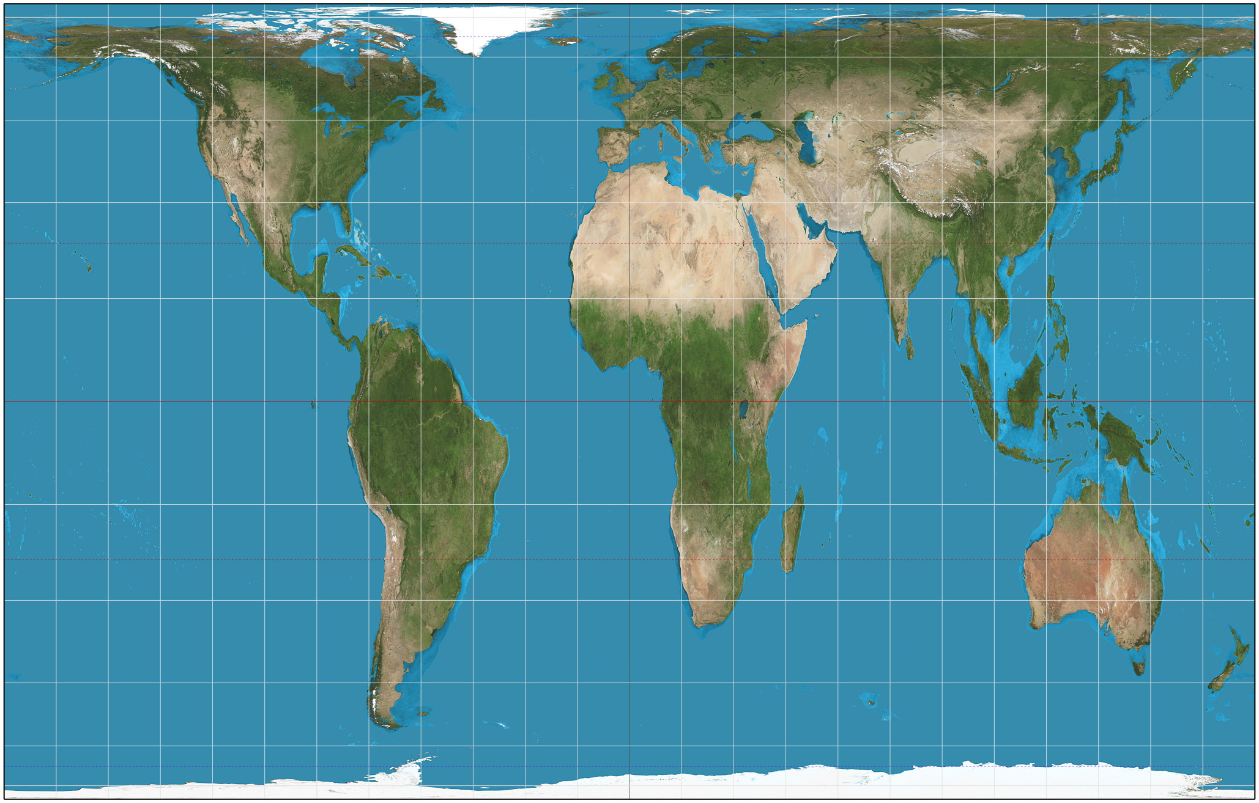

Slide 4
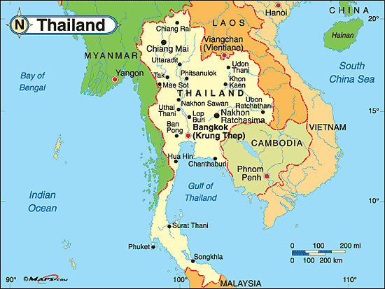

Slide 5
Capital: Bangkok
Population: 66,720,153 as of 2011
Official language: Thai
Currency: Baht
Religion: Buddhist 94.6%, Muslim 4.6%, Christian 0.7%, other 0.1%
Climate: Warm, humid and rainy mid-May to October; cool and dry November to mid-March
Agriculture: Rice, cassava, corn, sugarcane, coconuts
Resources: Tin, rubber, natural gas, timber, lead, fish
Major Industries: Tourism, clothing, beverages, cement, furniture, plastics

Slide 6
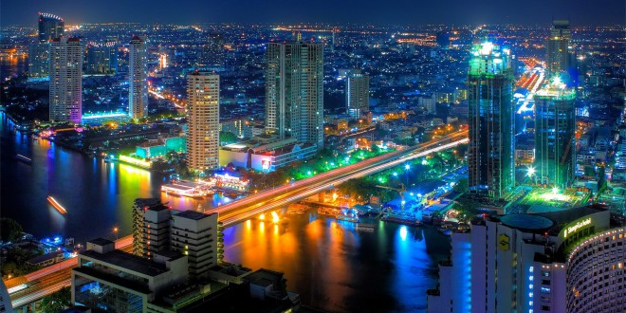

Slide 7
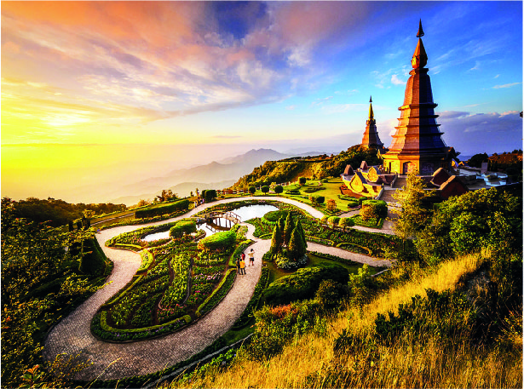

Slide 8
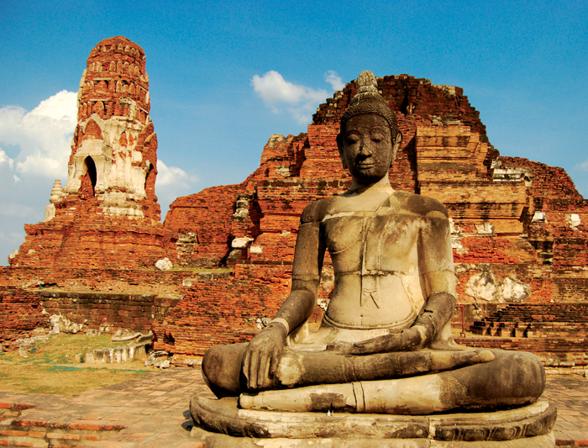

Slide 9
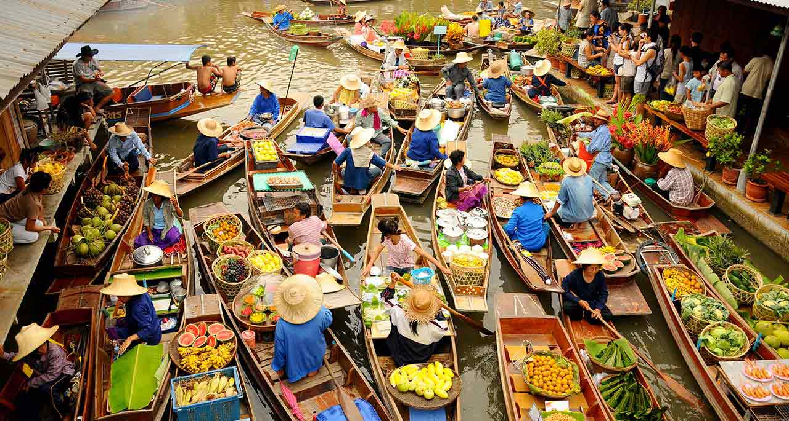

Slide 10
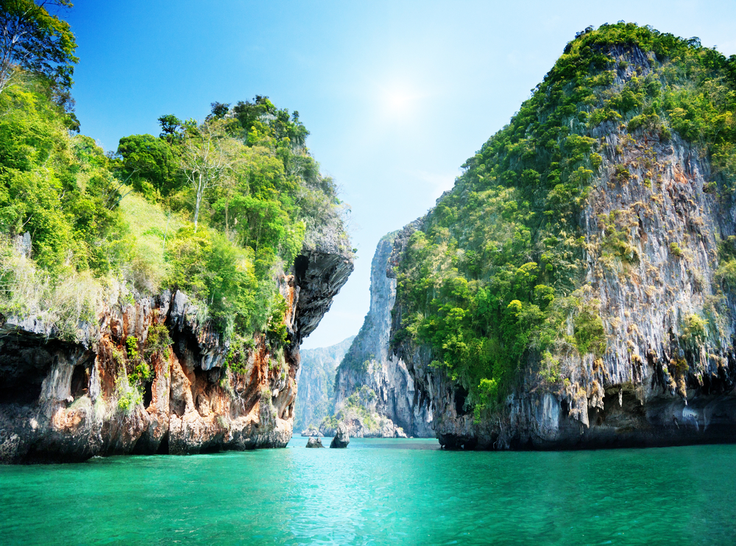

Slide 11
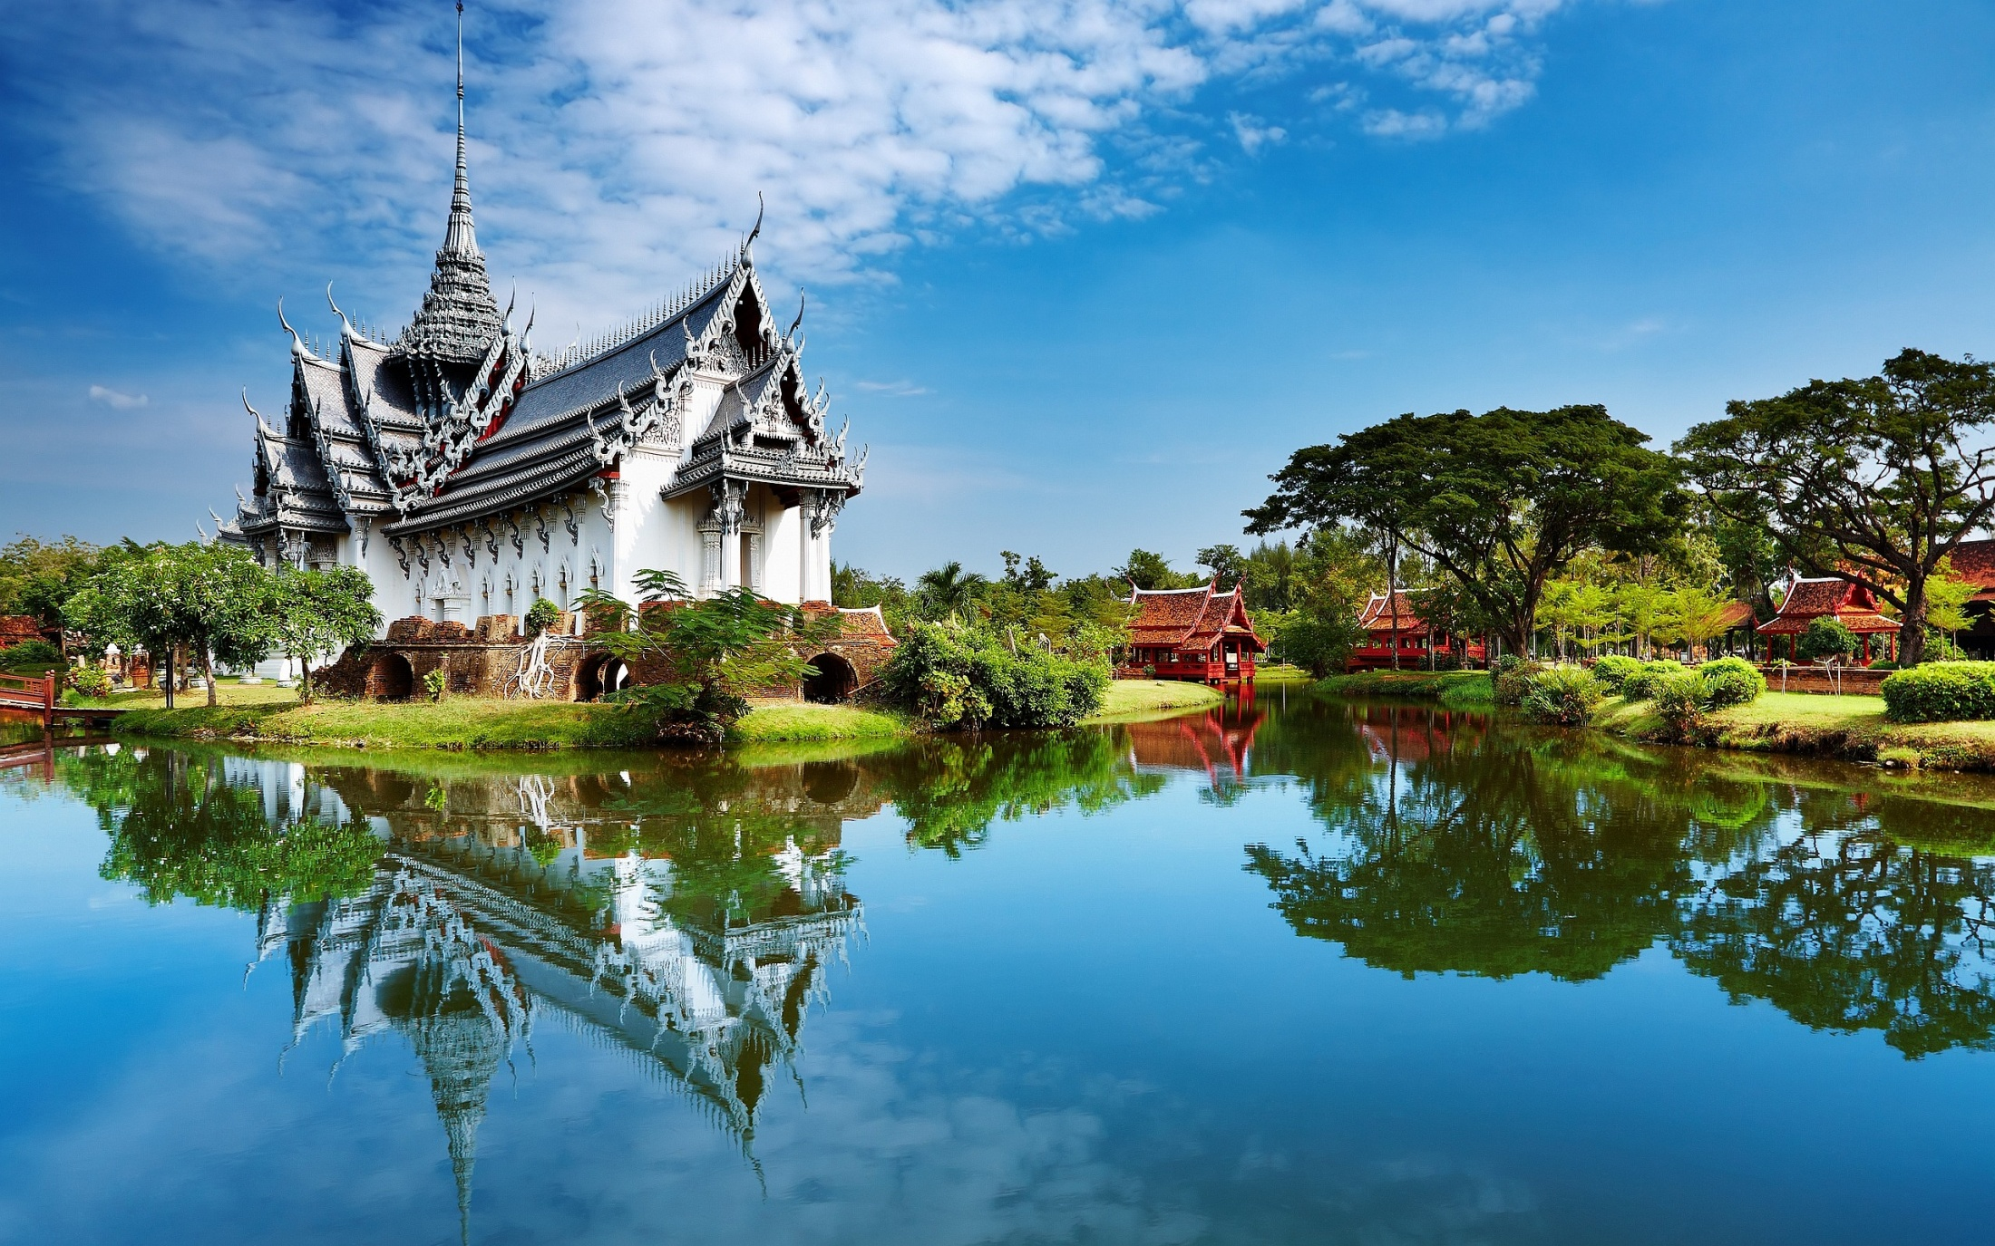

Slide 12
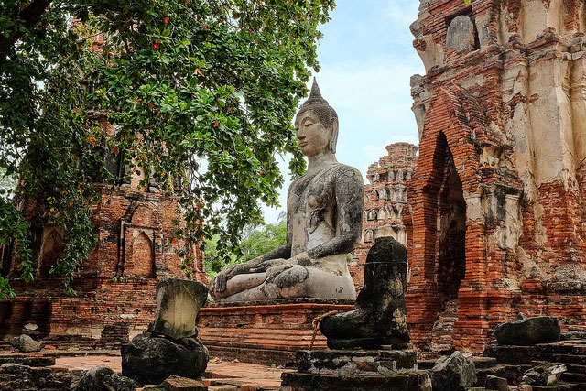

Slide 13
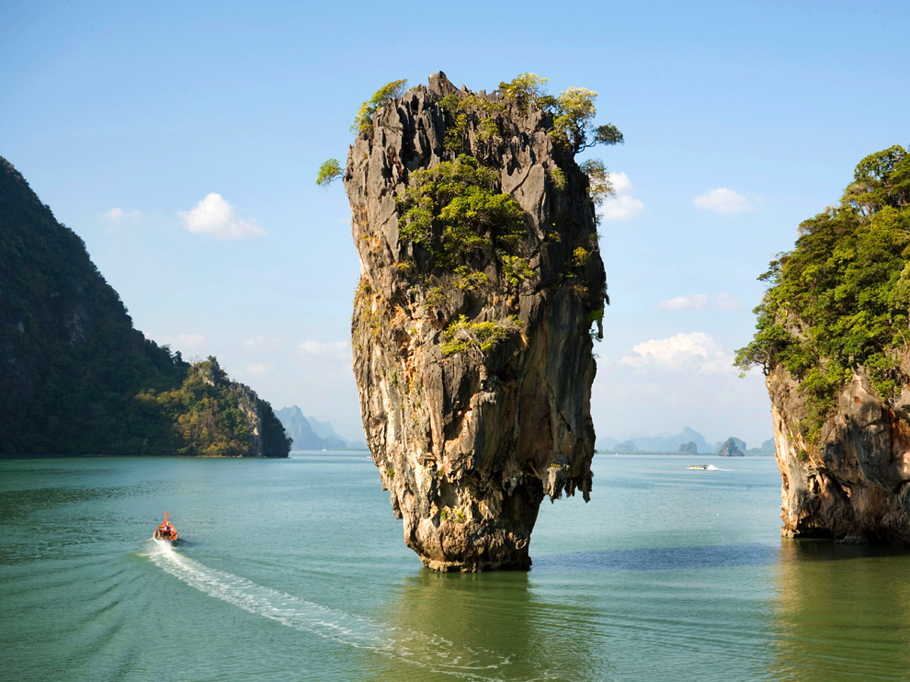

Slide 14
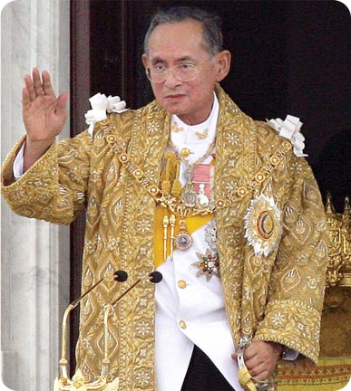
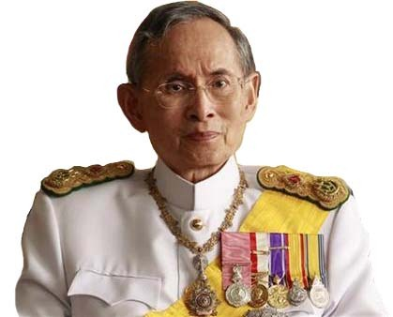

Slide 15
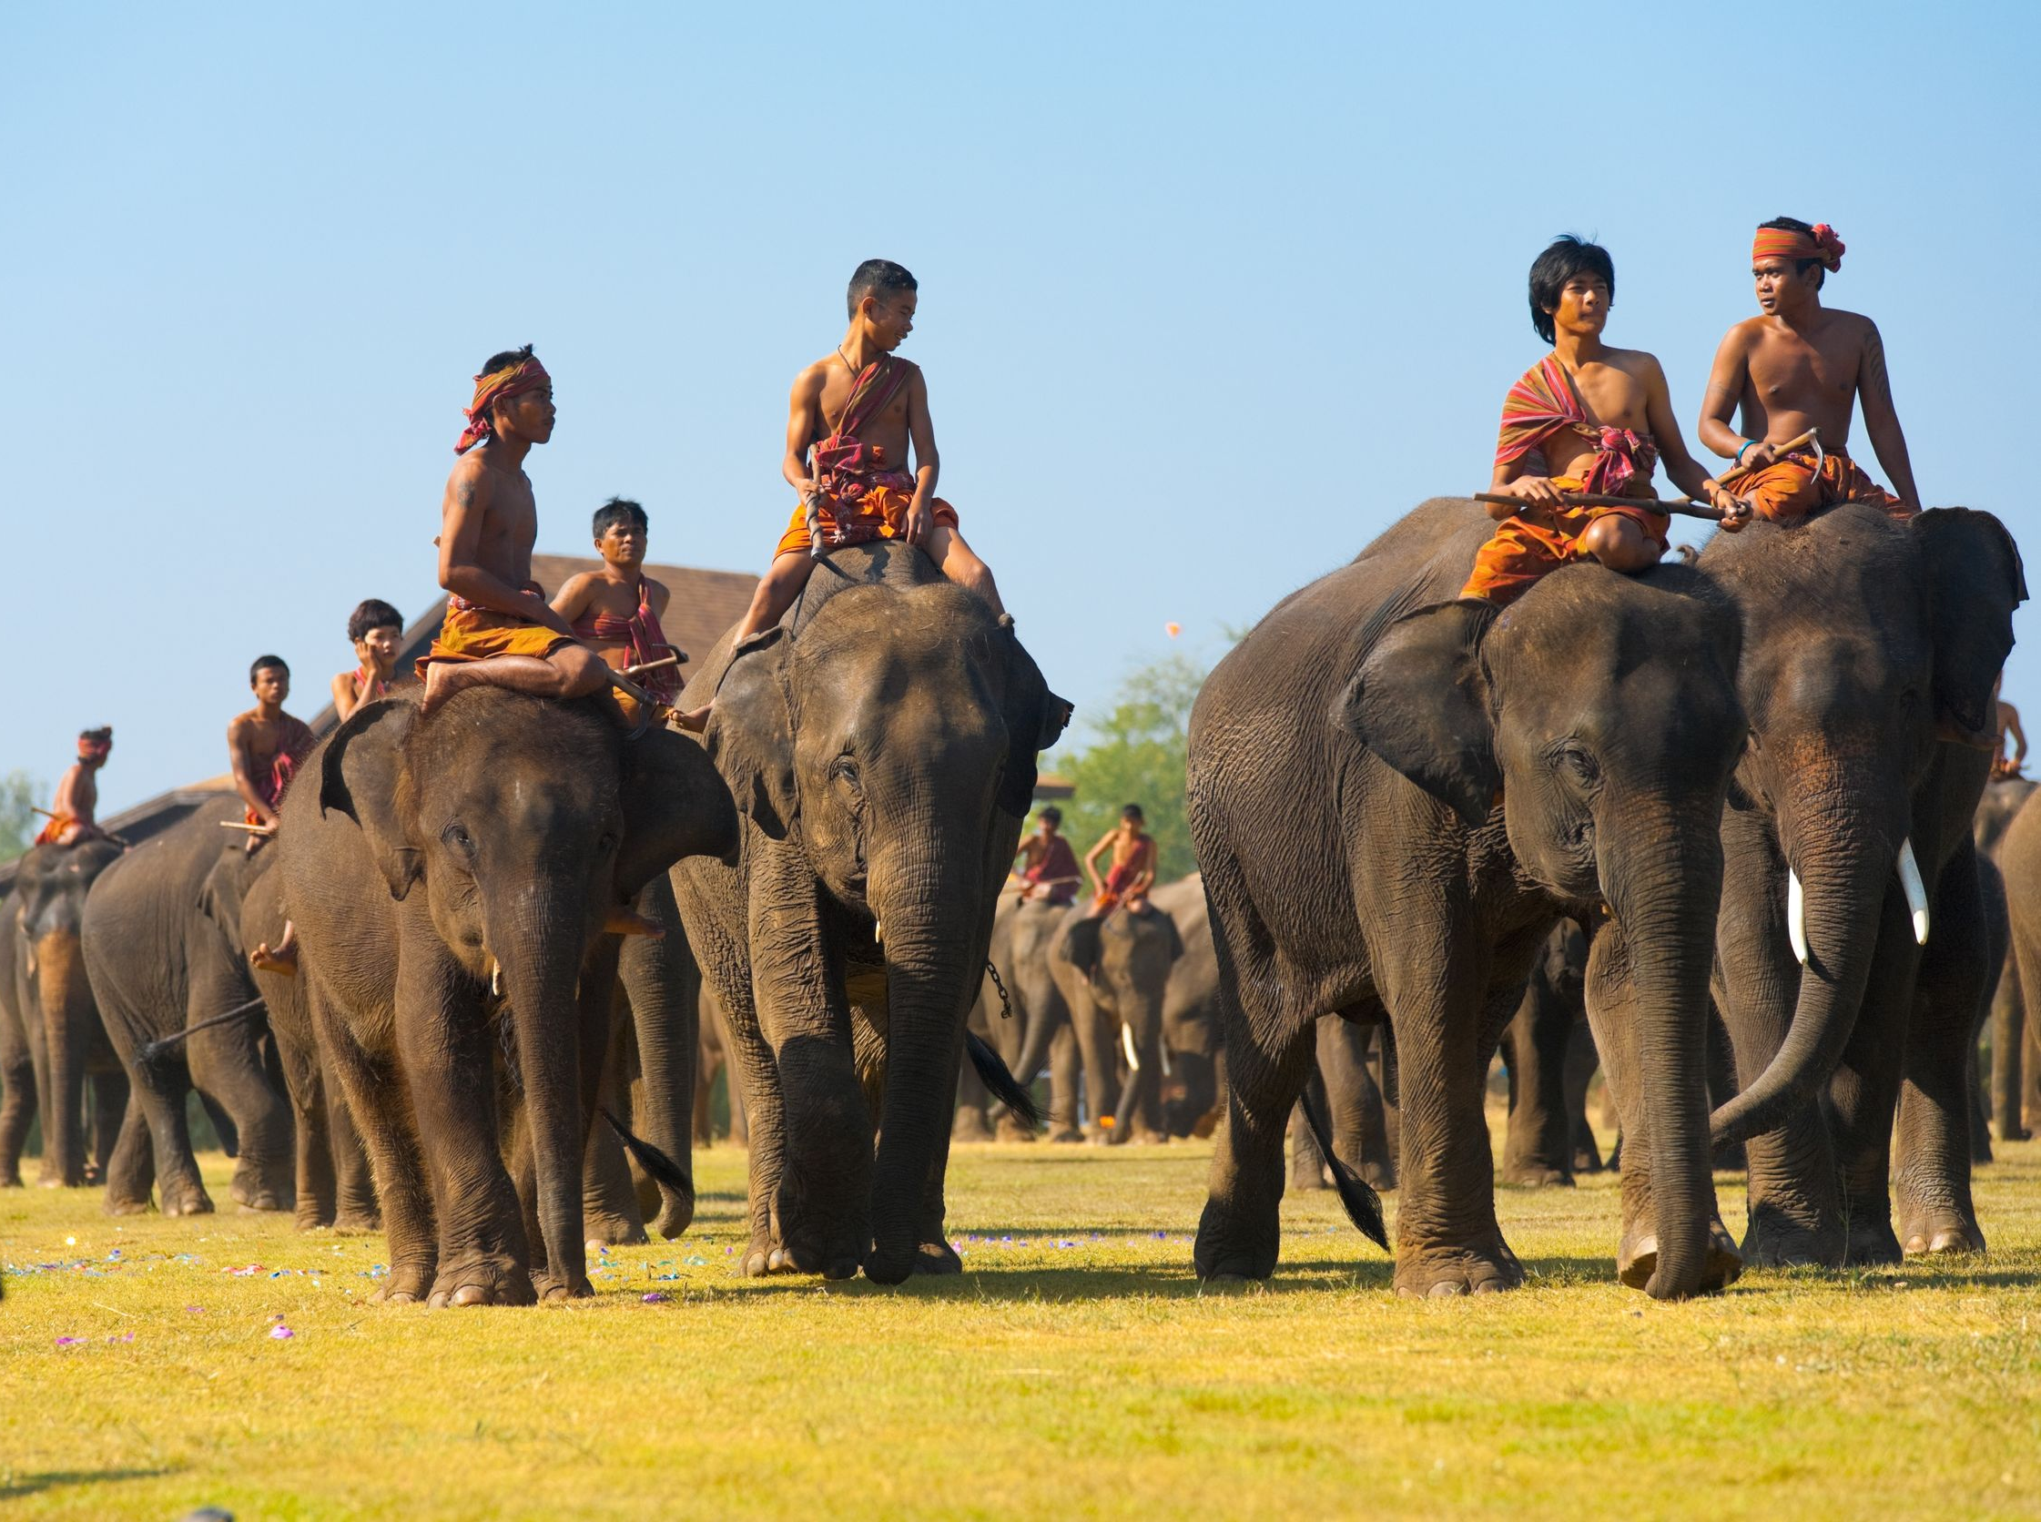

Slide 16
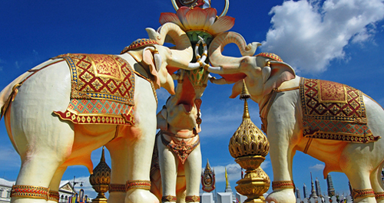

Slide 17
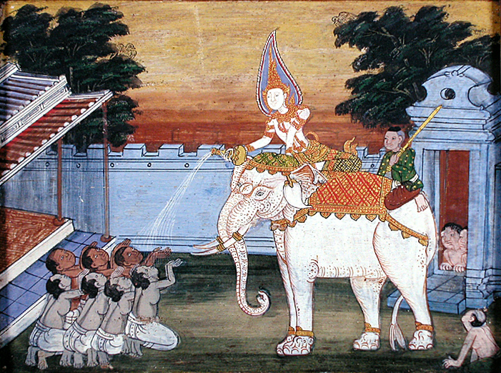

Slide 18
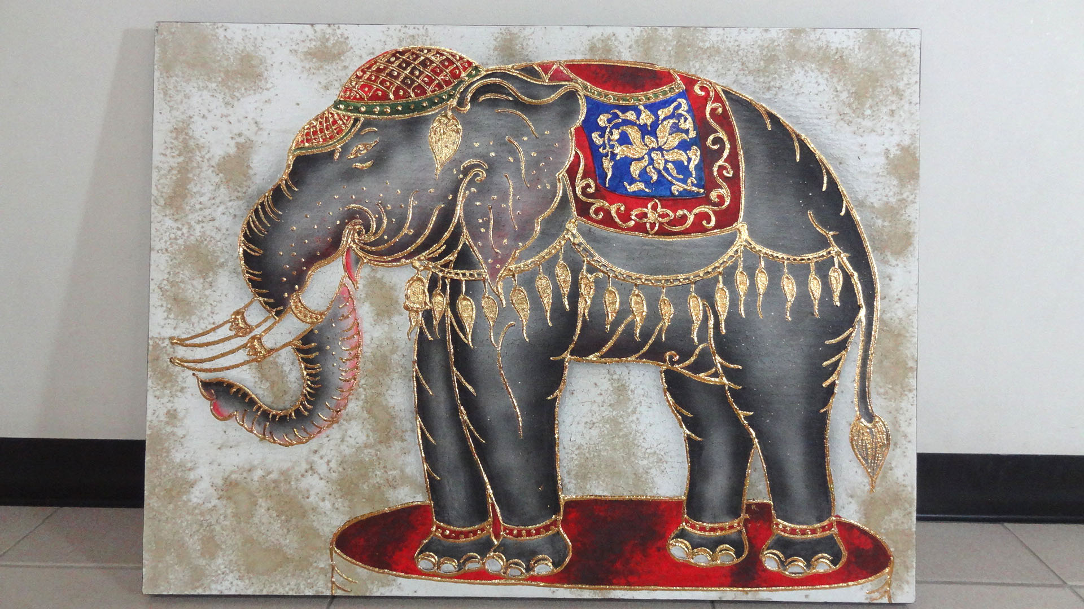

Slide 19
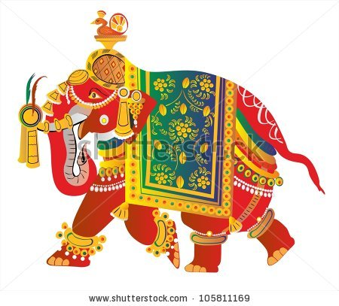

Slide 20
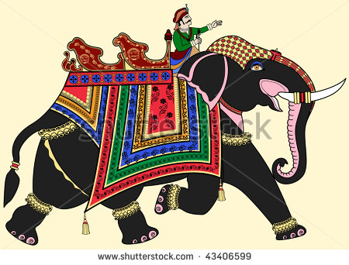

Slide 21
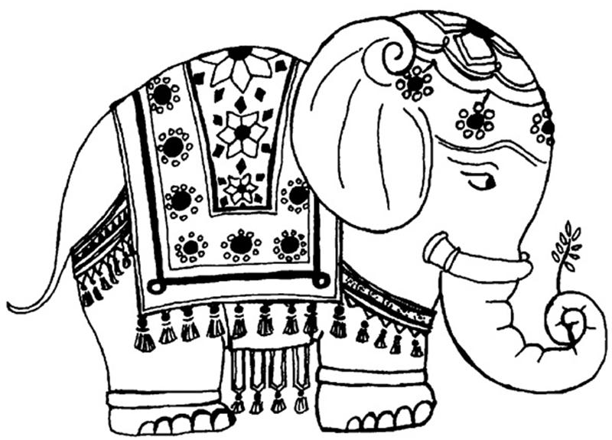

Slide 23
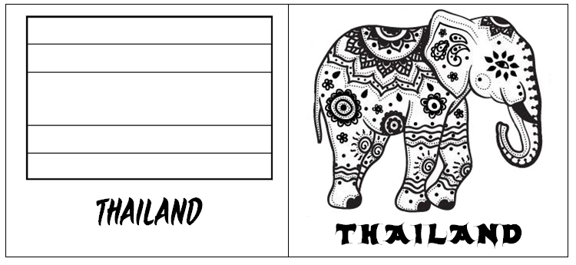

Slide 24
http://www.bbc.co.uk/languages/other/thai/guide/phrases.shtml

