Slide 1
Exploring the World
Today we visit...

Slide 2
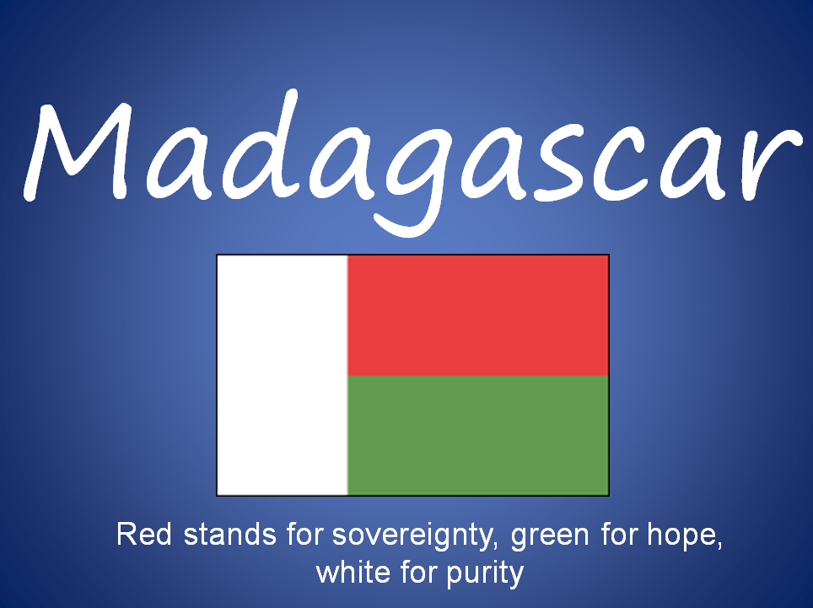

Slide 3
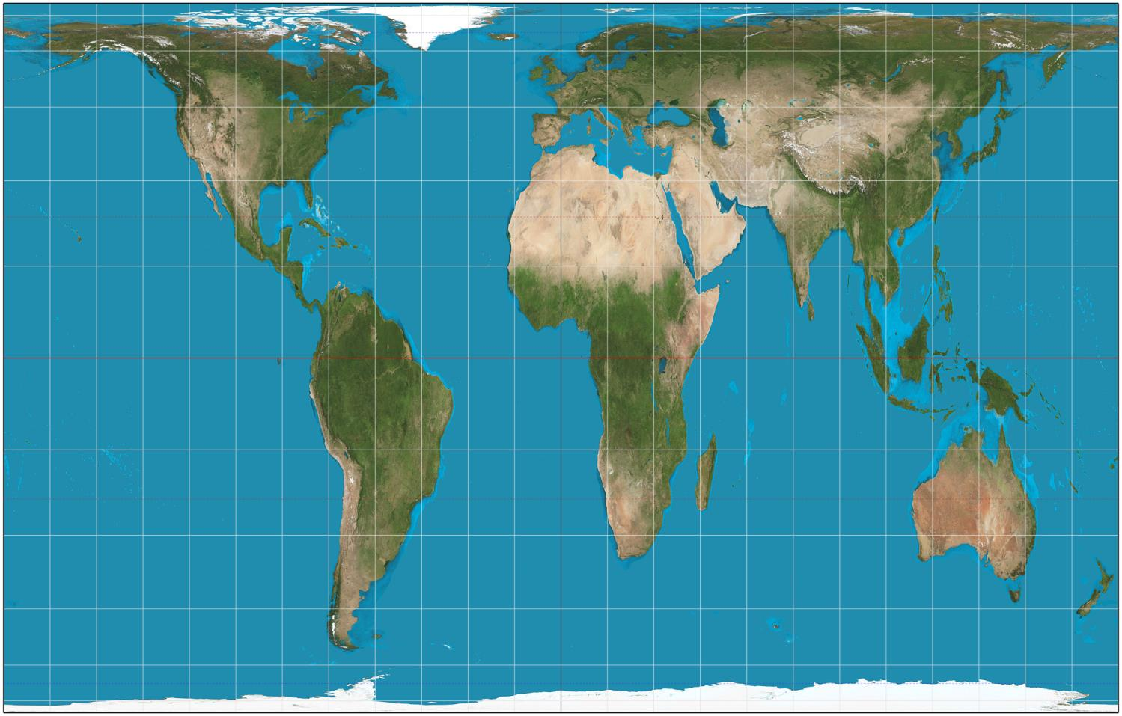

Slide 4
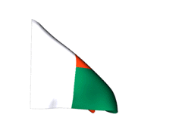
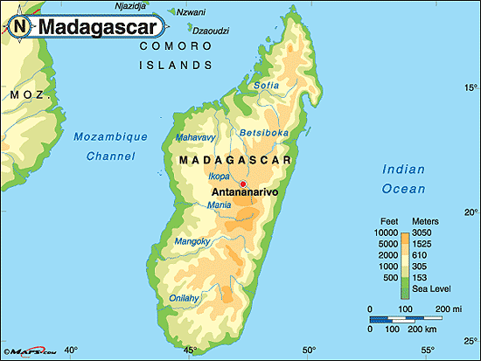

Slide 5
Madagascar is the world's 4th largest island.
The island is recognized as one of the world's top ten hotspots for biodiversity.

Slide 6
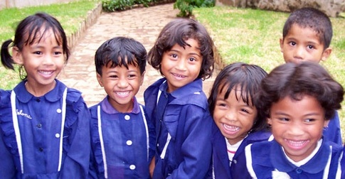
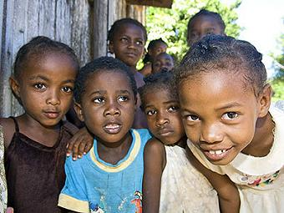
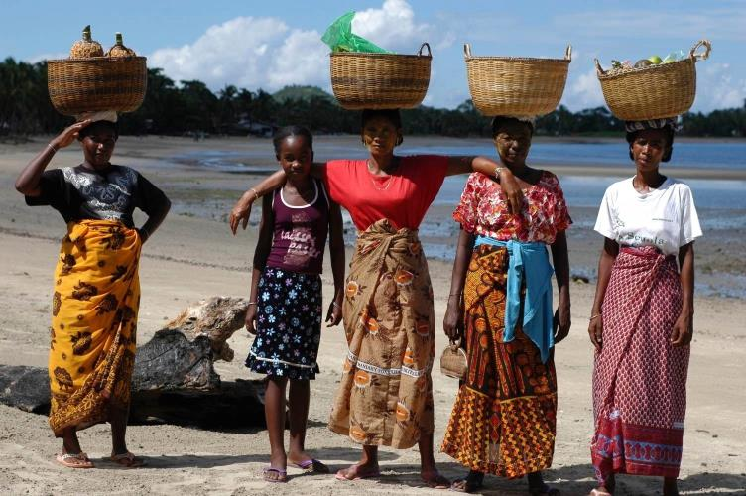

Slide 7
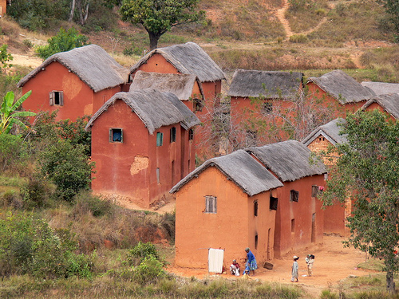
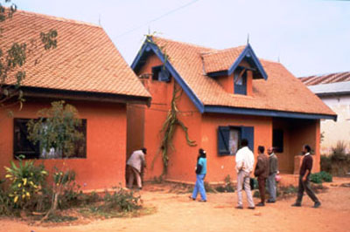

Slide 8
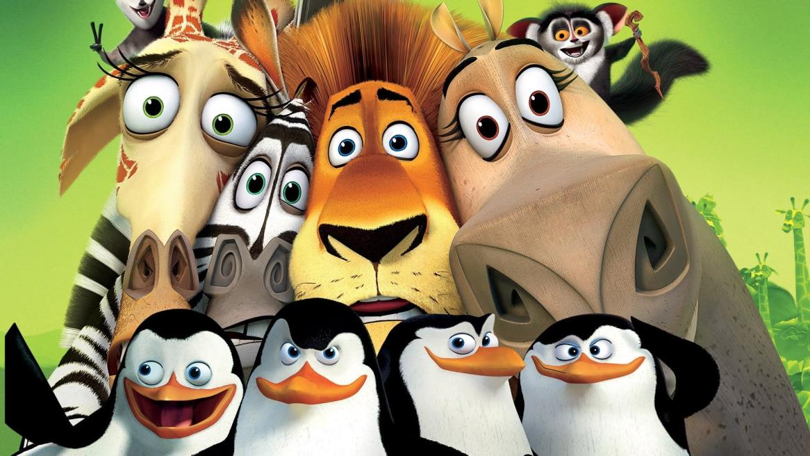
The Real Animals of Madagascar
http://www.wildmadagascar.org/wildlife/animals.html

Slide 9
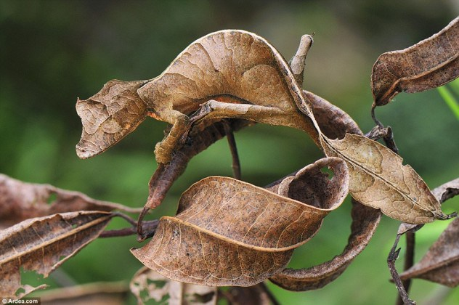
Flat-tailed geckos have to be seen to be believed, and that’s easier said than done. They’re masters of camouflage; each species has its own unique way of blending into its surroundings, some by mimicking decaying leaves and others by appearing as tree bark. Their coloration and light-reflecting body modifications render them nearly invisible to other creatures in the daytime. There are more than 10 species of flat-tailed gecko, all indigenous to Madagascar and its surrounding islands.

Slide 10
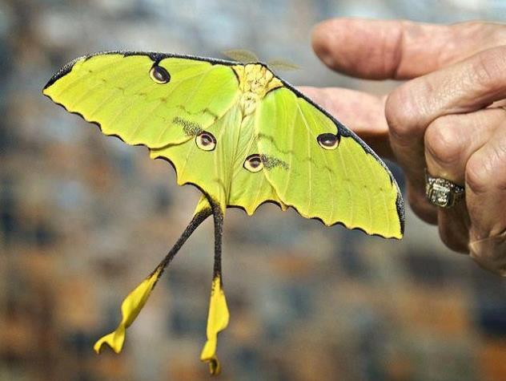
Comet moths, also known as Madagascan moon moths, are among the world’s largest silk moths. Their brightly colored wings can reach spans of 20 centimeters (eight inches), while their namesake tails can grow up to 15 centimeters (six inches)..

Slide 11
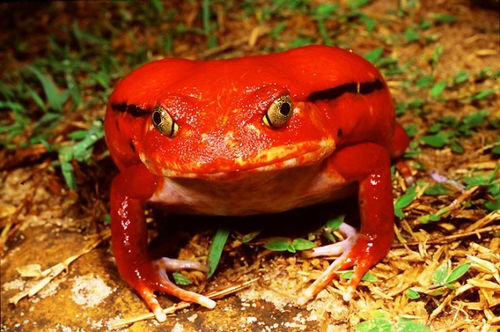
Tomato frogs are ambush predators, found only in the northern, wetter parts of Madagascar. They prey mostly on insects, but they’ve been known to eat anything they can fit in their mouths.

Slide 12
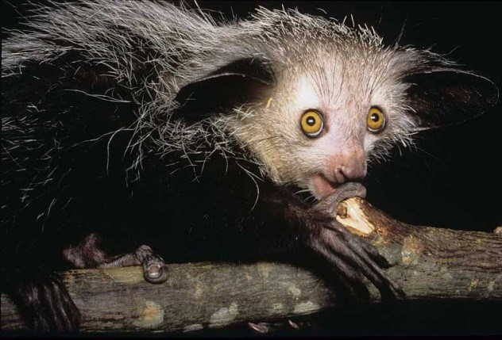
Their name suggests they should live on pirate ships, but aye-ayes are actually only found in Madagascar. More remarkably, aye-ayes are the only primates that use echolocation to find their prey; they use their long middle fingers to tap on trees and listen for wood-boring insect larvae, using the same finger to dig them out of the tree when it finds them. Their large, sensitive ears and big eyes might be useful for finding food, but their bizarre appearance and behavior has caused the human inhabitants of Madagascar to consider them an omen of bad luck, and like many Madagascan animals, they are currently considered endangered.

Slide 13
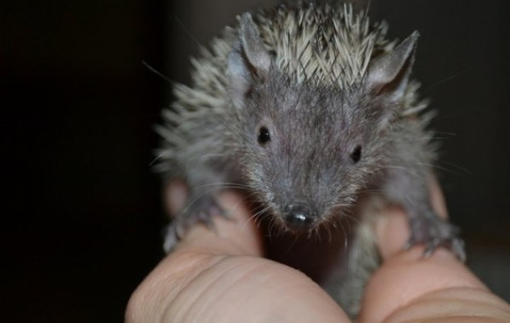
Aquatic tenrecs are among the most elusive species in the world. They’re only found at 10 sites in Madagascar, and since the biggest of these ratlike creatures are only 17 centimeters (6.7 in) long, they’re hard to spot. There are a number of tenrec species in Madagascar, but aquatic tenrecs are unique for their water adaptations: large hind-limb muscles and webbed feet perfect for swimming in the waters of Eastern Madagascar. They trawl shallow bodies of water for insects and tadpoles, rubbing the sensitive vibrissae (whiskers) on their snouts against the bottom. Once they locate their prey, they drag it to the surface, roll onto their backs, and subdue it with kicks from their hind feet.

Slide 14
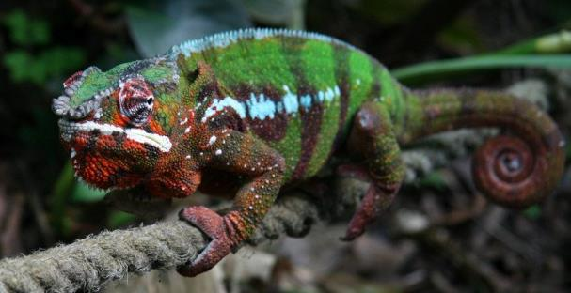
Like other chameleons, panther chameleons change color according to their mood, but these particular chameleons are usually vibrantly colored, especially the males when courtingThey have the ability to rotate and focus their eyes independent of one another to simultaneously observe two objects. When they spot their prey, panther chameleons turn their heads to lock both eyes onto the target before striking with their long, sticky tongues. The tongue creates a suction effect when it hits the chameleon’s prey, which couples with the innate stickiness to prevent anything from escaping.

Slide 15
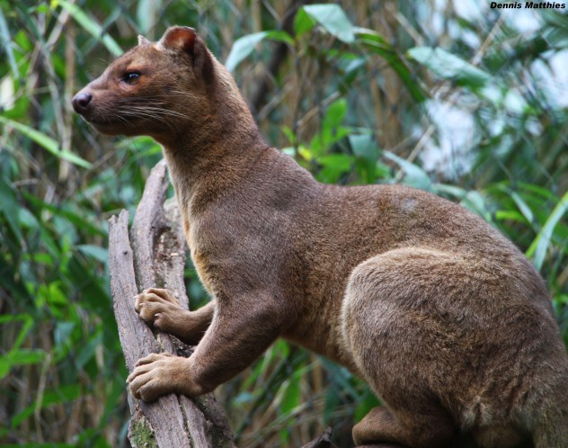
Fossas, have doglike snouts and catlike bodies. Fossas are nocturnal, and over half of their diet consists of lemurs. They also eat reptiles, birds, other mammals, and livestock. They’re incredibly agile, with their long tails giving them excellent stability when moving from branch to branch, and their claws are retractable, meaning they stay sharp and aren’t worn down on the fossa’s travels.

Slide 16
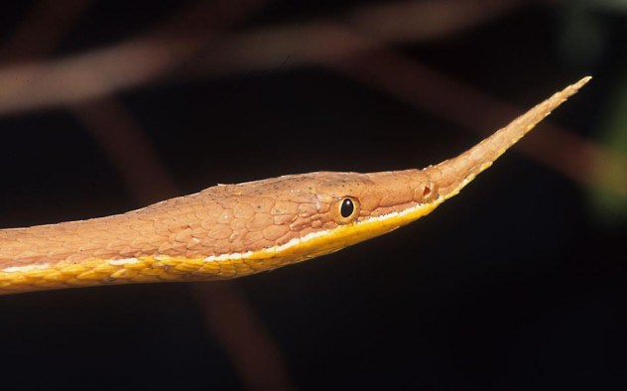
The vast majority of Madagascar’s snakes are unique to the island, but few are so strange to the eye as Malagasy leaf-nosed snakes. These snakes, which like to hang from branches high in the trees, have bizarre nasal appendages protruding from their faces.

Slide 17
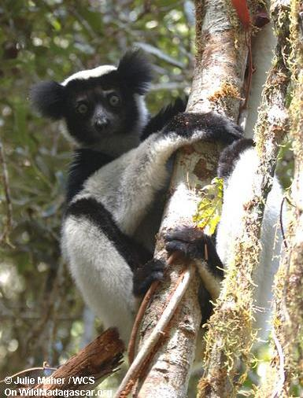
Lemurs

Slide 18
Black lemur The black lemur lives in the tropical forests of northern Madagascar. Black lemurs are notable for the differences between the sexes. Males are black while females have reddish-brown fur with a black and white face. Black lemurs feed on fruit, flowers, and young leaves.
Indri The indri is the largest living lemur. Black and white in color, the indri is famous for its eerie wail that sounds a bit like the song of a humpback whale. The indri feeds on fruit and leaves in the canopy of the rainforests of eastern Madagascar. Today the indri is endangered due to habitat loss. MORE | Hear the indri's song

Slide 19
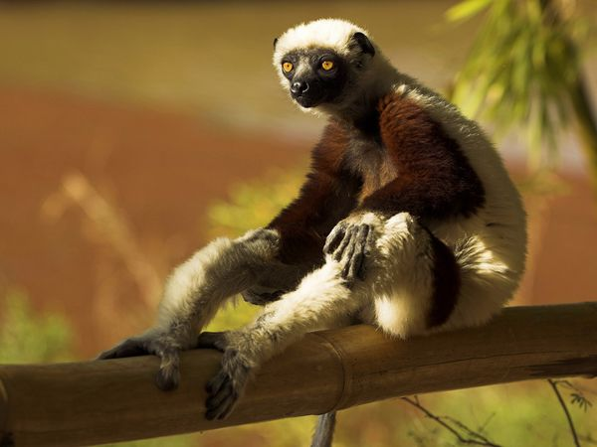

Slide 20
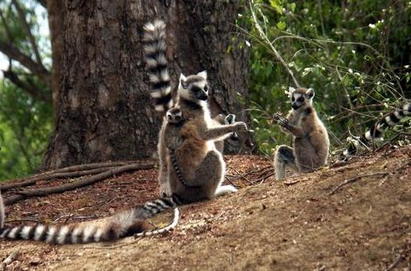

Slide 21
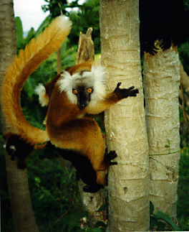

Slide 22
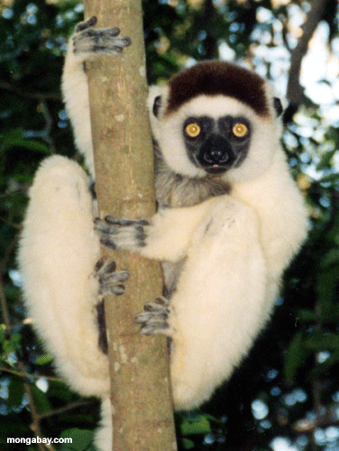
Sifakas are relatiely large lemurs found throughout Madagascar. Verreaux's sifaka lives in the dry forests of western and southern Madagascar, where it feeds on leaves, fruit, and flowers. Sifakas are quite vocal with a variety of calls. Sifakas are sometimes known as "dancing lemurs" for their mode of locomotion when they cross open ground: sifakas do not move about on all fours—instead they sashay on their hind legs while holding their arms aloft MORE | See the "sifaka dance"
http://video.wildmadagascar.org/

