Slide 1
Exploring the World
Today we visit...

Slide 3
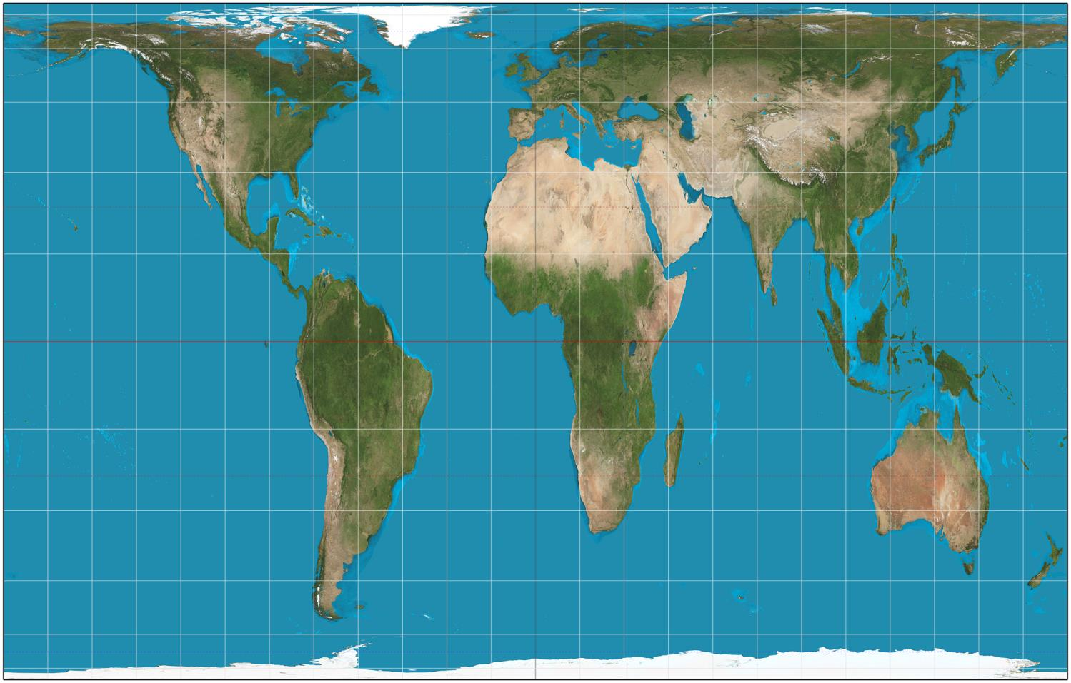
https://www.google.com.au/maps/@-27.3235945,140.8165486,4970705m/data=!3m1!1e3?hl=en

Slide 4
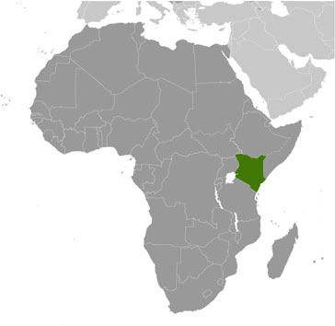

Slide 5
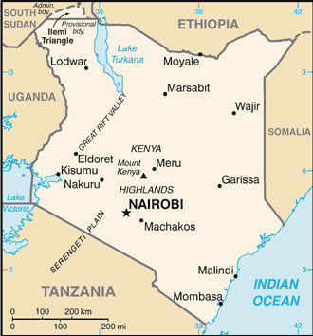

Slide 6
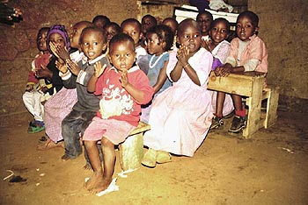
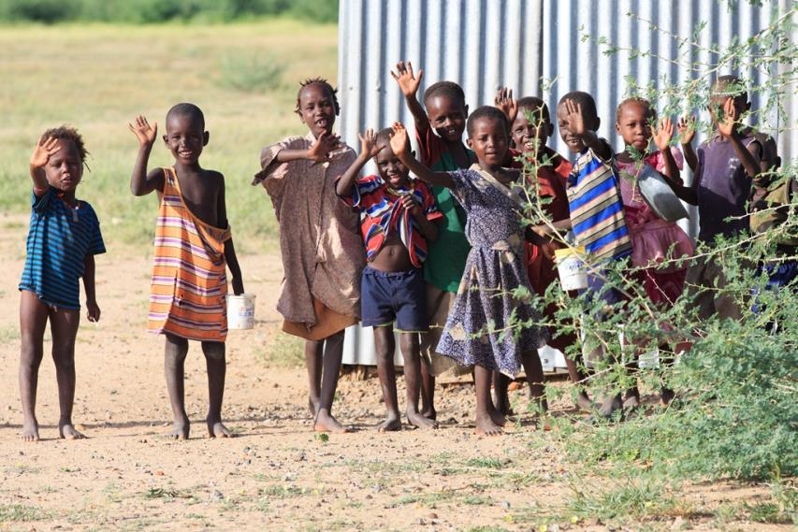
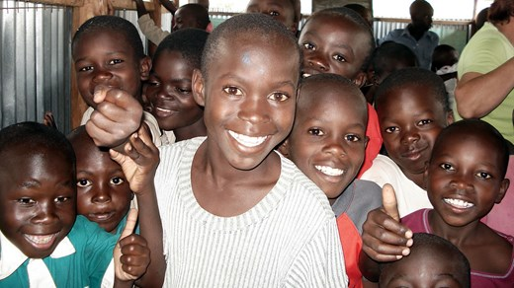
The population of Kenya is estimated to be around 43 million.
Kenya is a developing country and half of the population live in poverty.

Slide 7
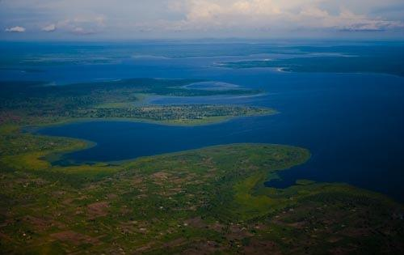
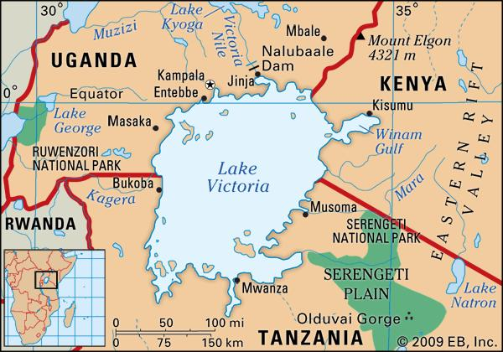
Kenya shares Lake Victoria, the world's second largest fresh water lake, with Tanzania and Uganda.

Slide 8
One of the original peoples to live in Kenya are the Masai tribe. They were great warriors and hunters.

Slide 9
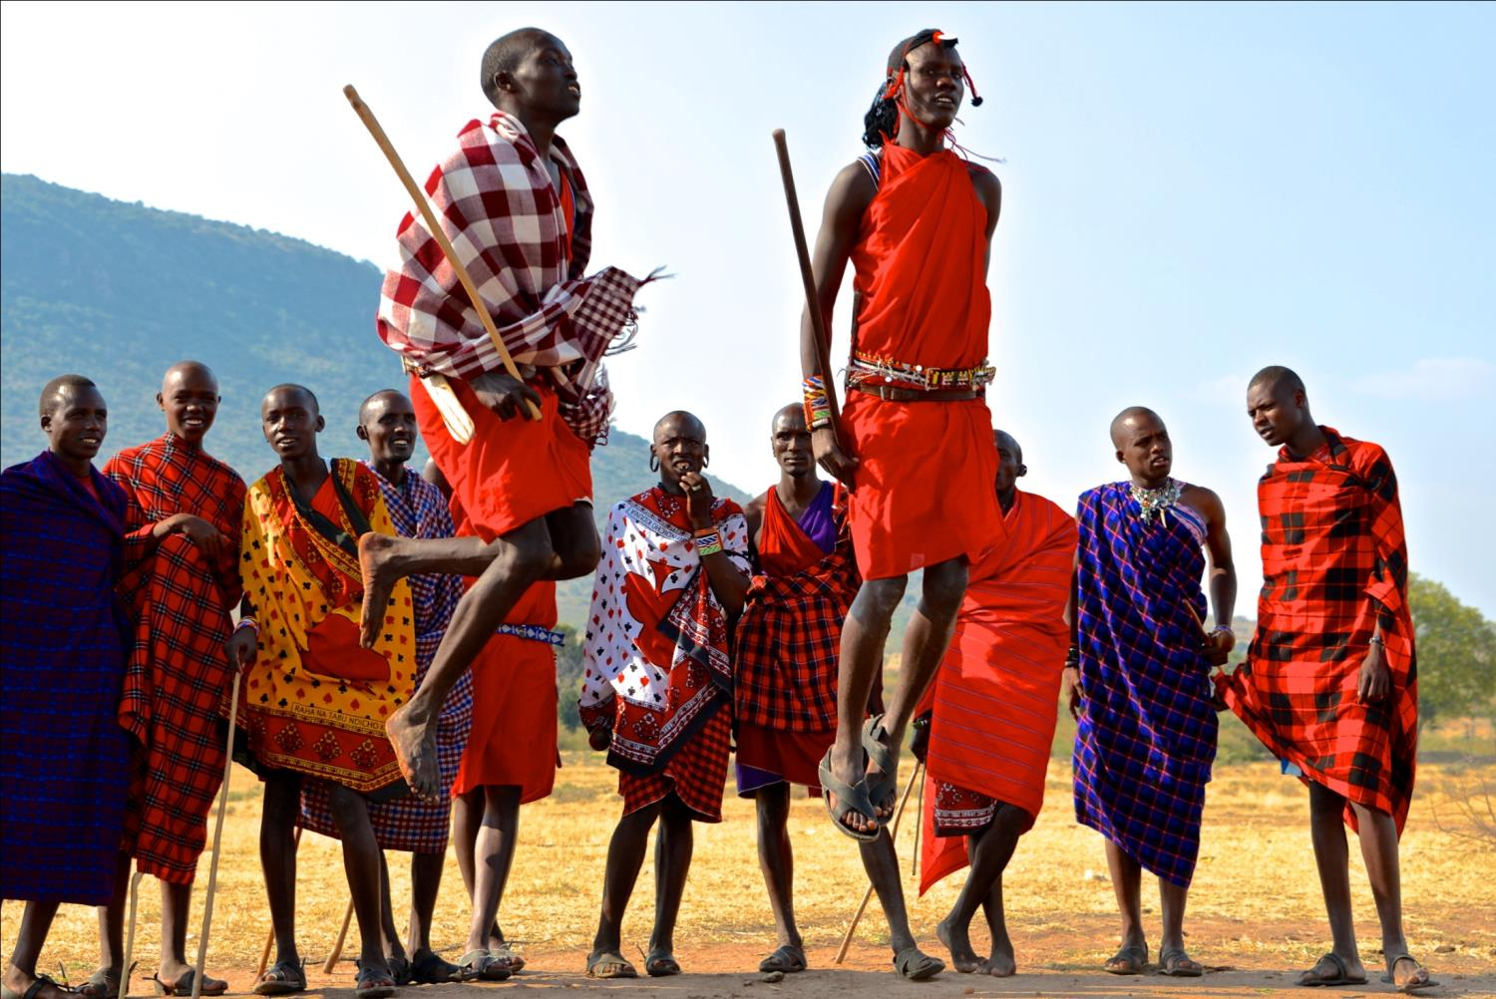

Slide 10
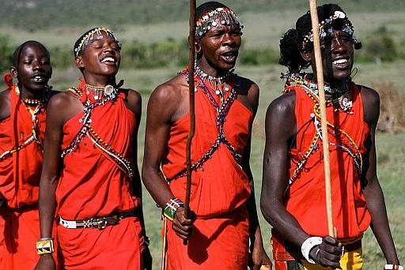

Slide 11
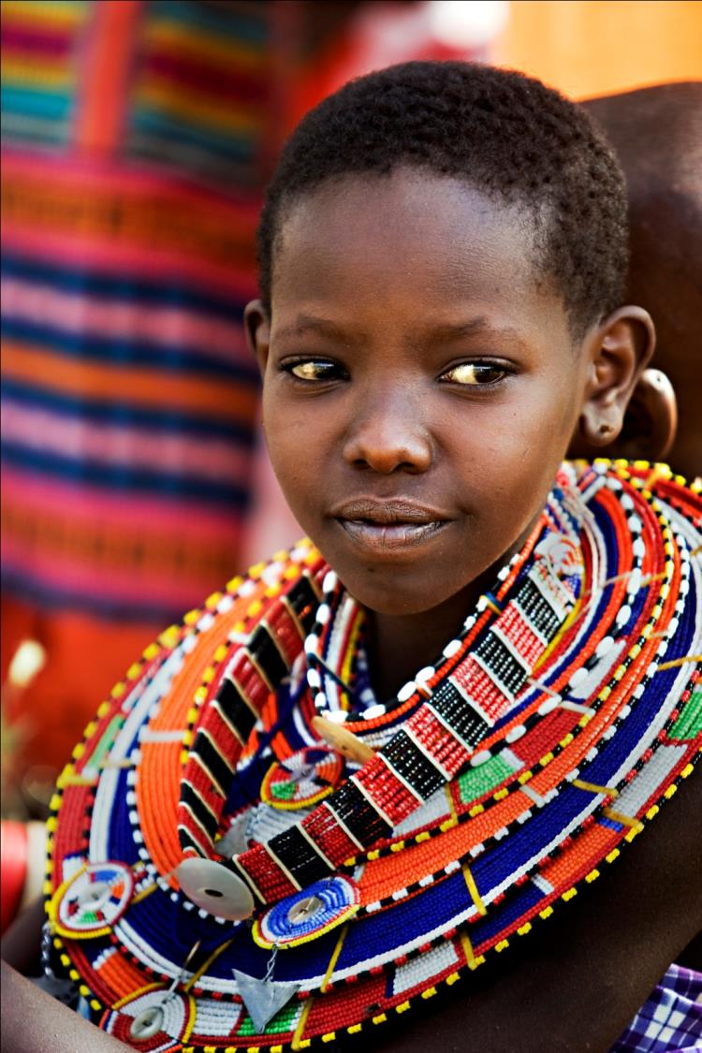

Slide 12
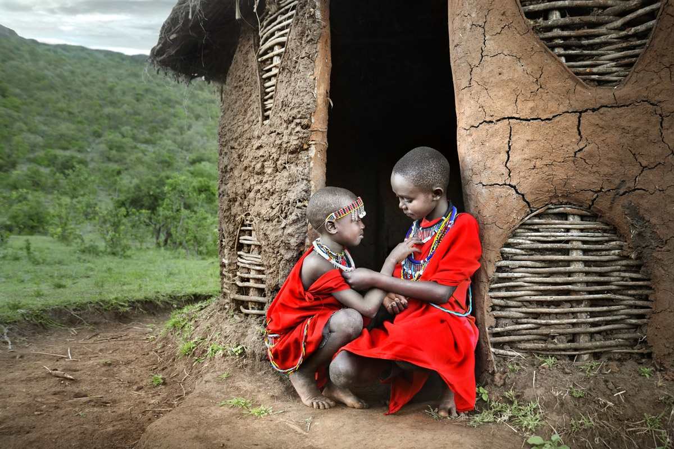

Slide 13
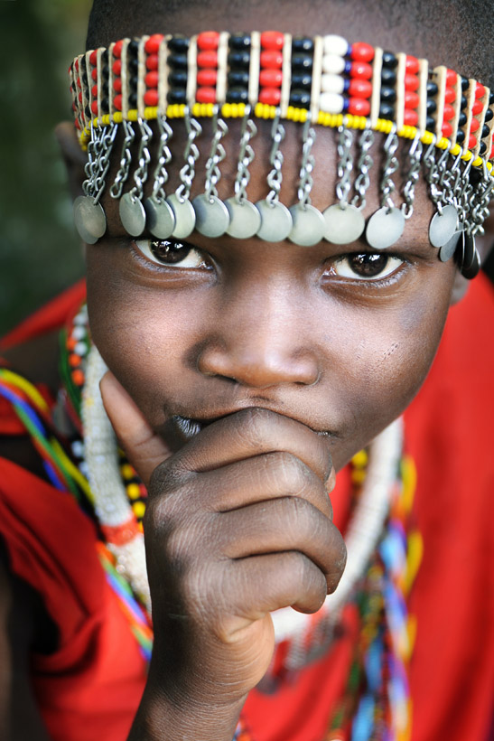
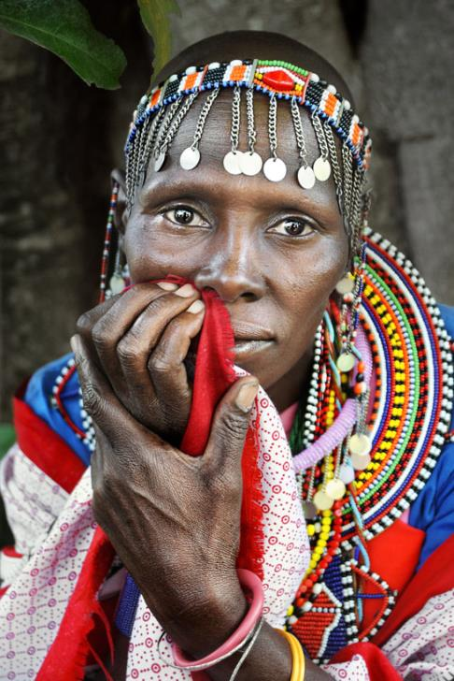

Slide 14
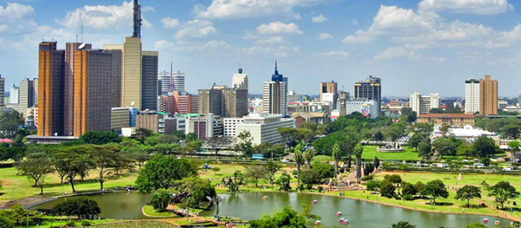
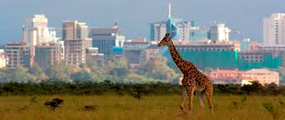
The capital and largest city is Nairobi. Mombasa is the second largest city.

Slide 15
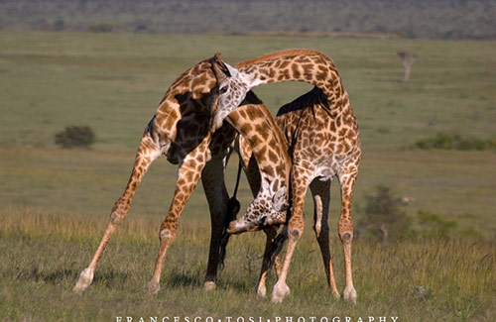
Kenya features many national parks and wildlife reserves, with safaris being a popular activity for visitors.

Slide 16
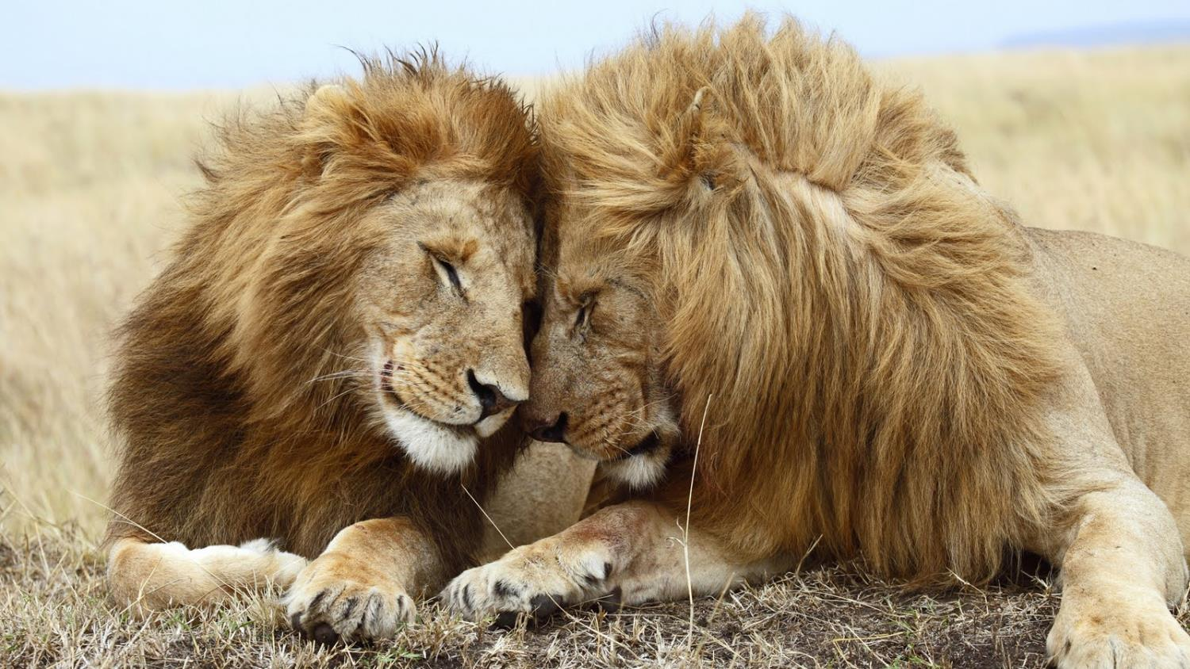

Slide 17
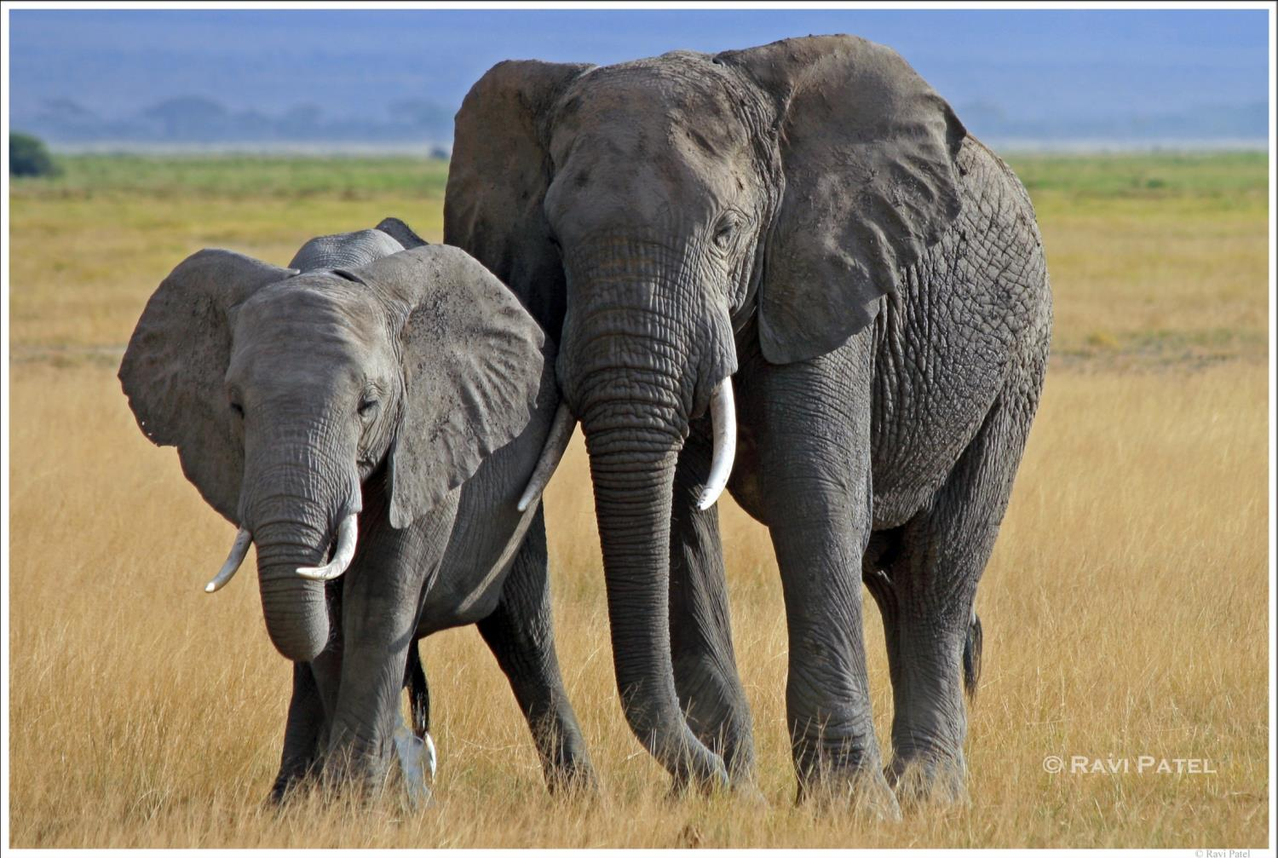

Slide 18
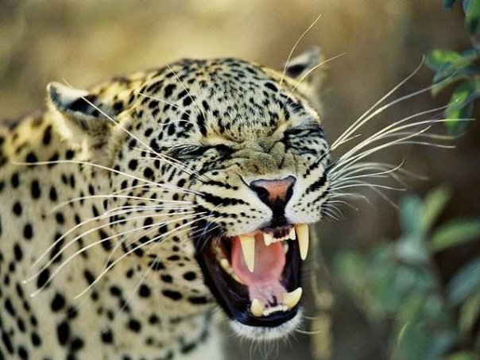

Slide 19
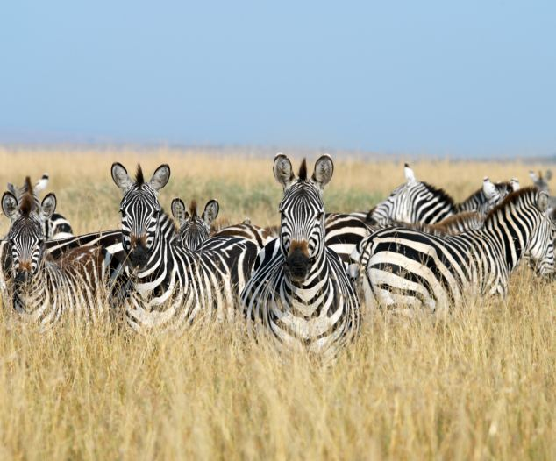

Slide 20
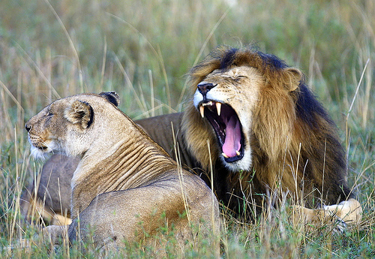

Slide 21
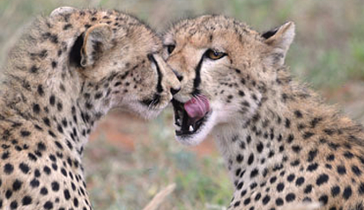

Slide 22
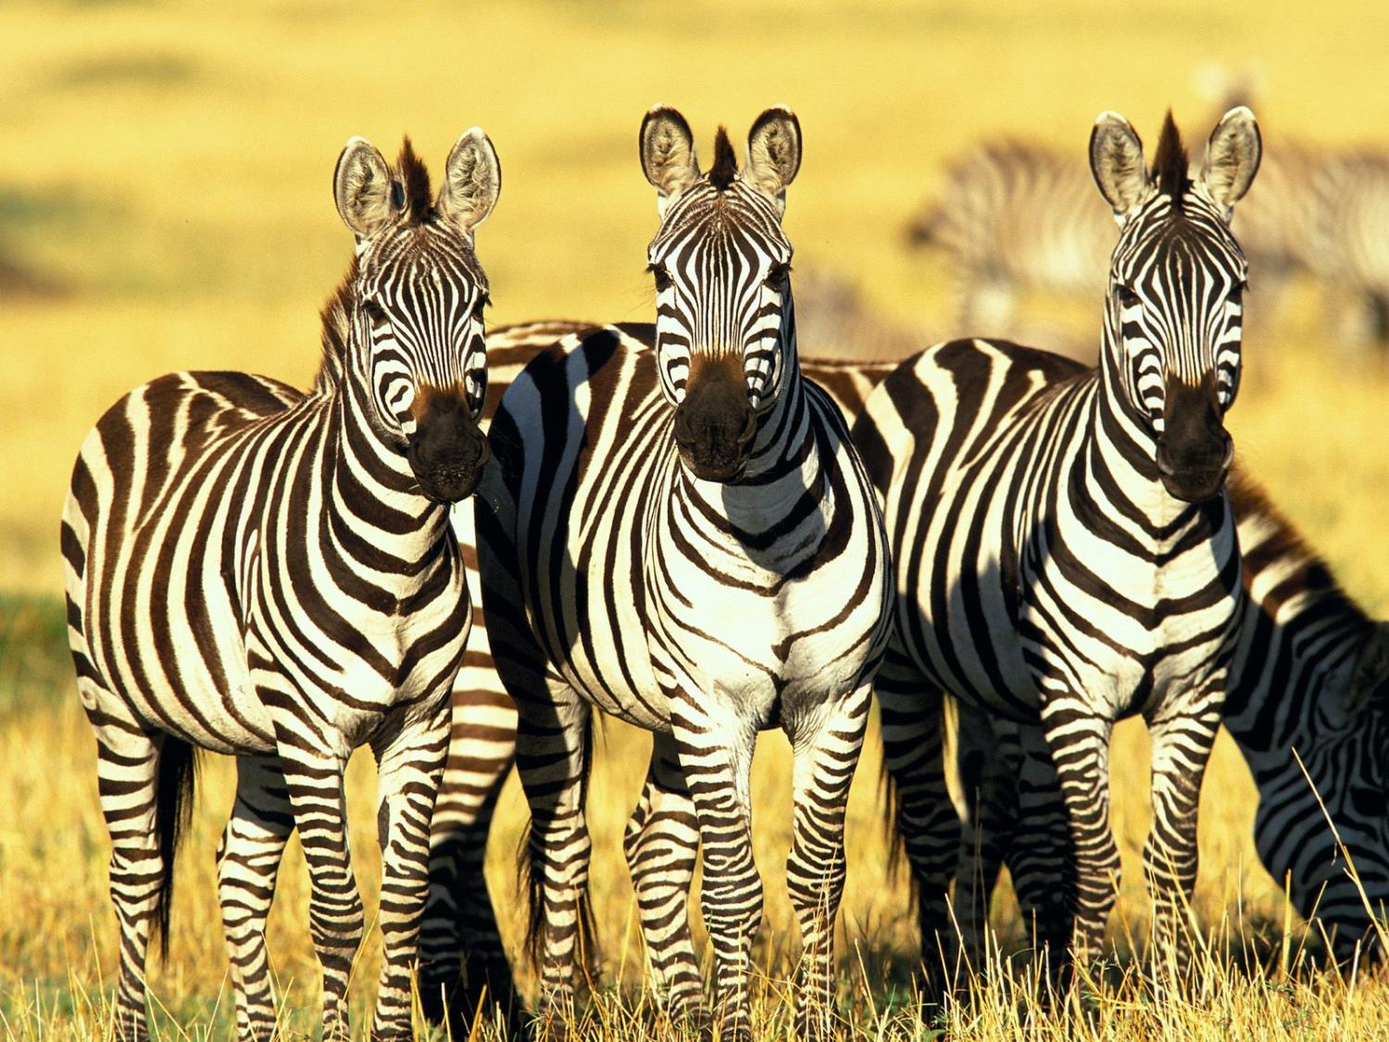

Slide 23
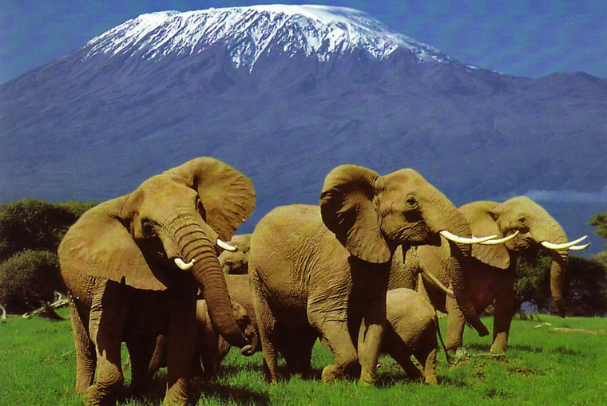
Kenya is named after Mt Kenya, the tallest mountain in the country (5,199 metres).

Slide 24
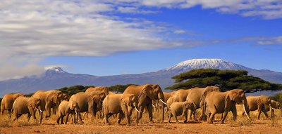

Slide 25
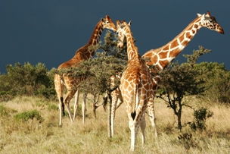

Slide 26
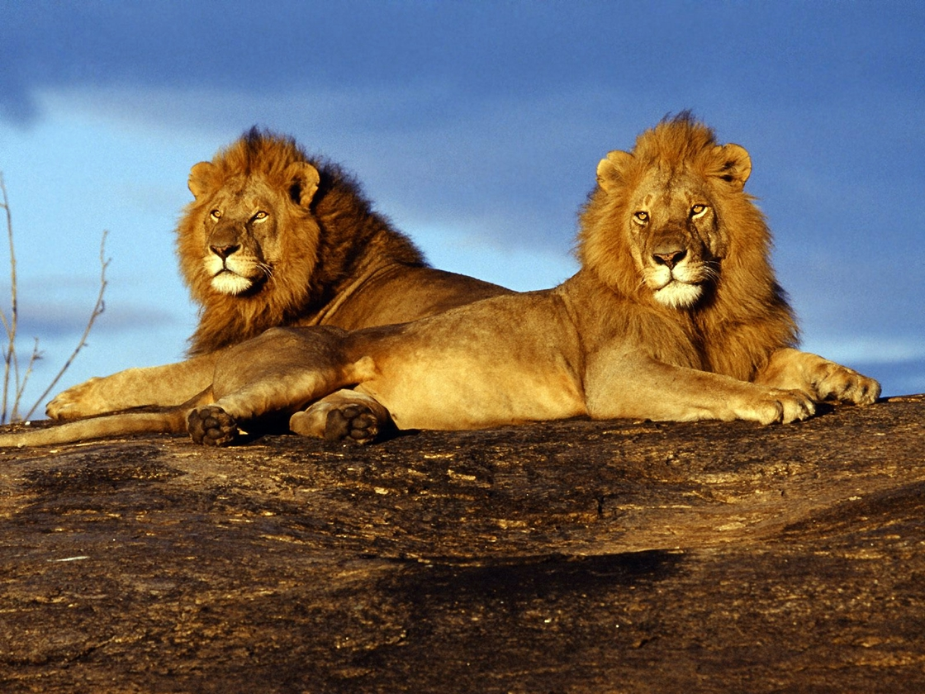

Slide 27
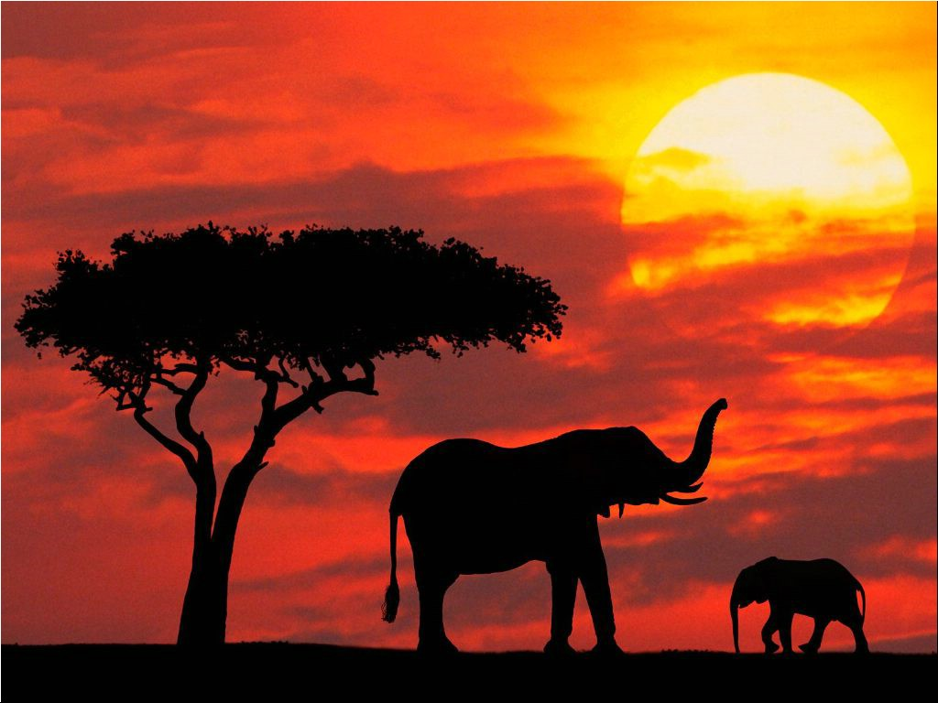

Slide 28
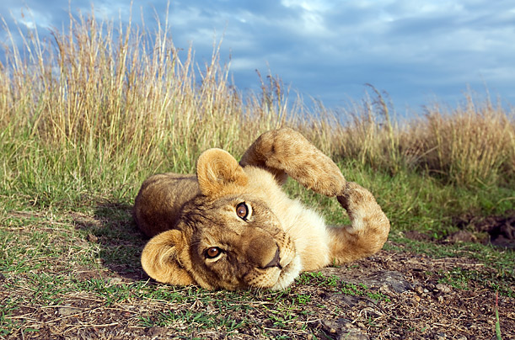

Slide 29
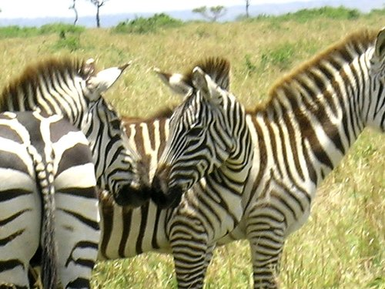

Slide 30
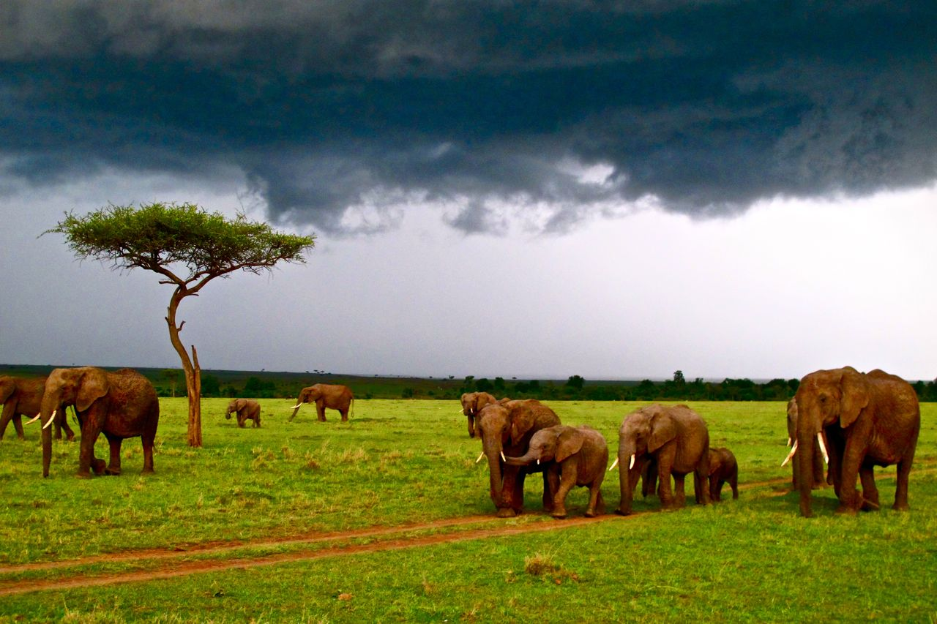

Slide 31
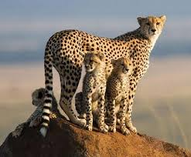

Slide 32
Let’s see what it’s like for a boy growing up in Kenya
http://www.timeforkids.com/destination/kenya/day-in-life

Slide 33
Kenyans speak English and Swahili. We can listen to some words in Swahili.
http://www.timeforkids.com/destination/kenya/native-lingo
The two official languages in Kenya are English and Swahili, although there are dozens of other languages spoken in various parts of the country.

Slide 34
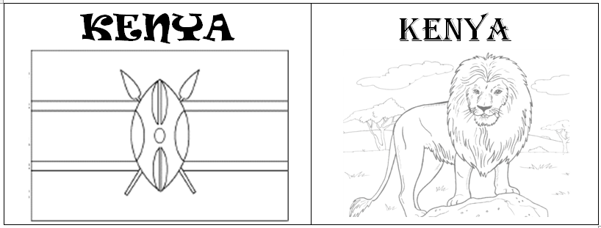
Here are the stickers for your suitcase and passport.

Slide 35
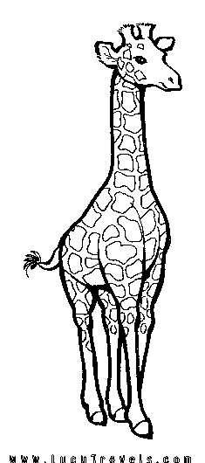
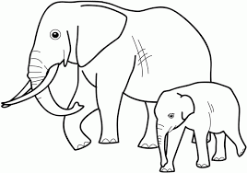
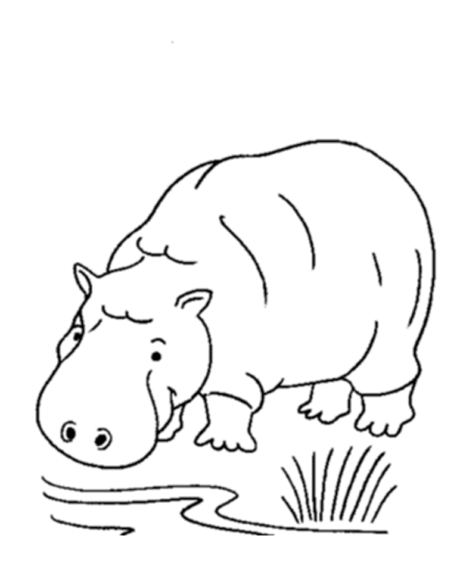
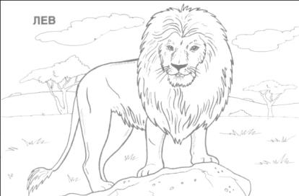
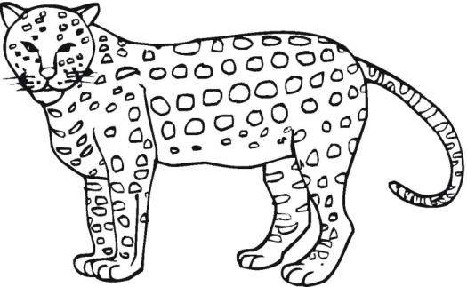
Today we’ll make a mural of some of the animals you can find in Kenya. Can you think of more?

